Slide 1
Welcome to Primary 5!
Meet the teacher presentation
(2021)

Slide 2
Our Classroom
Morning routine:
1. School Day: 8:50am-2:50pm
2. Hang jackets and bags in the cloakroom
3. Place water bottles in the baskets
4. Wash hands at the sink
5. Emotional Check-in/ Quiet reading
6. Morning prayers
7. Lunches/Plan for the day
8. Morning starter

Slide 3
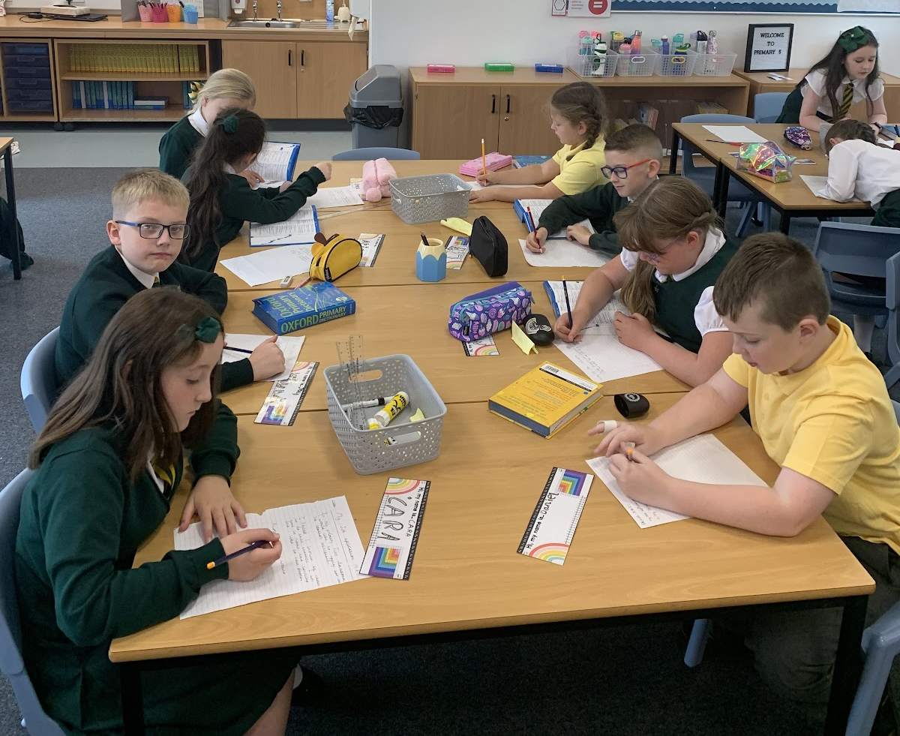
Have a look inside our classroom!
https://youtu.be/t9c9gluIm-E

Slide 4
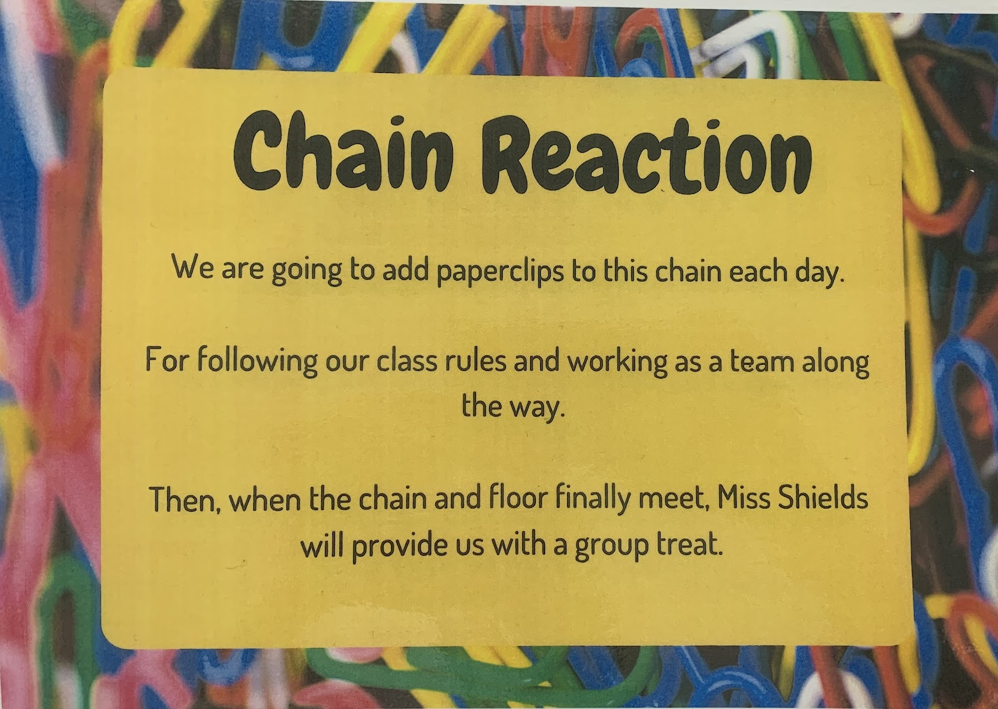
Promoting Positive Behaviour
RRS – Ready Respectful Safe.
St Marks Way (individual) – Start on Green each day – move up to bronze, silver & gold. Move down to amber & red.
Lunchtime reflection (red on St Marks Way) – time to reflect on what has went wrong.
Chain Reaction (group points for following class rules)
Whole class reward (Bubble Pop-It)
Mystery Walker (Sticker awarded to children for walking quietly)
Golden Time 20-25 minutes on Friday afternoon.

Slide 5
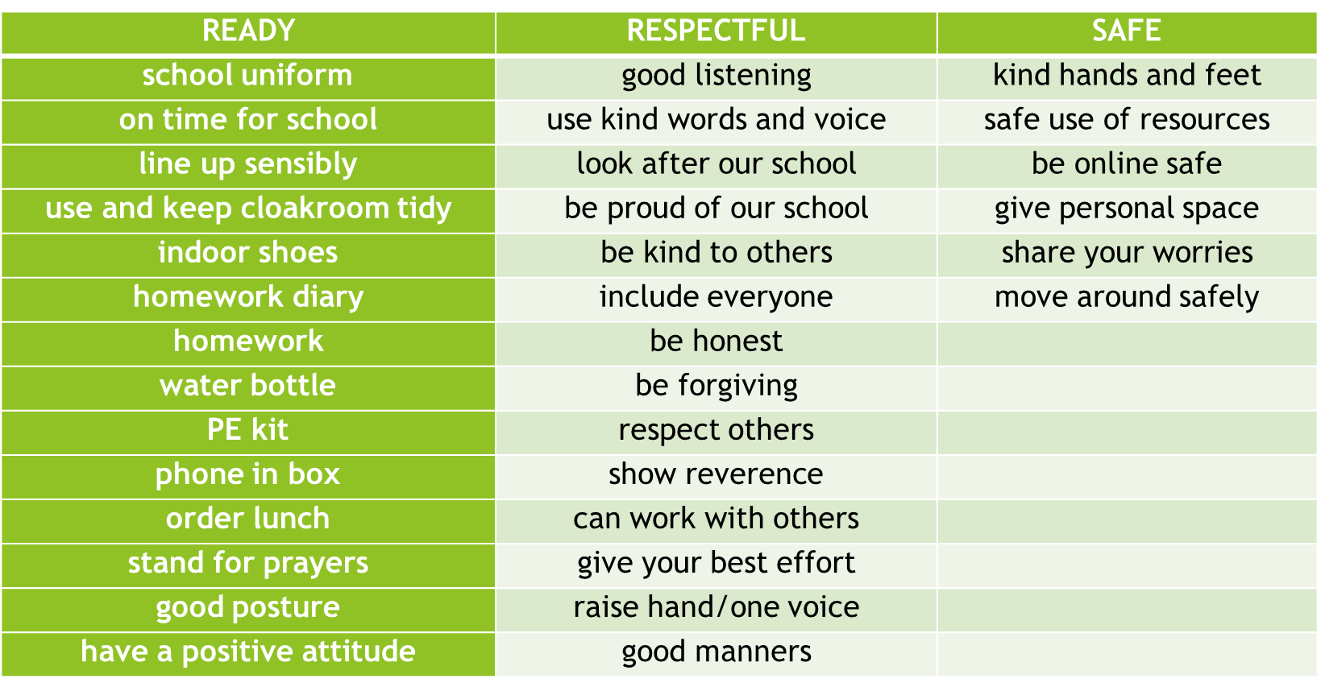
Ready, Respectful & Safe

Slide 6
The St Mark’s Way
All pupils start on green every day.
Relates to RRS – move up for being ready to learn, respectful to others and safe within the school.
Move down for not showing respect, not working hard and being unsafe in the school or playground.
Finish on red – lunchtime reflection on the following day.

Slide 7
Numeracy:
Maths starter
Follow up tasks
Teacher led
Mental Maths and ICT activities
In class
-Maths bot starter: differentiated questions
-Whole class games
-Independent activities based on Learning Intention and Success Criteria
-Working from a variety of resources e.g. SHM, TJ maths, HAM
-Whole class activities
-Introducing new concepts
-Topmarks, Sumdog & RM Easimaths

Slide 8
Reading
Spelling
Reading books – Literacy World & Rapid Reader
Reciprocal Reading – using reading skills to develop understanding of a text.
ERIC time – 15 minutes daily reading of children's own choice of book.
Teacher led reading: Pie Corbett
(Class novel: Why the Whales Came- Michael Morpurgo)
Comprehension – Focus on Comprehension, Reading Book follow up, topic based comprehension.
Phonological awareness and Spelling: North Lanarkshire Active Literacy Programme, phonics and common words.
Active approaches: games, magnetic letters, Five finger rule, multi-sensory spelling activities.
Blending sounds to attack words
Dictionary/ Thesaurus Skills

Slide 9
Writing
Literacy at home
Reading – encourage 15 minutes per night of reading. Ask questions throughout & spot ‘WOW’ words (adjectives).
Spelling – Doorway Online
Typing – BBC Dance Mat, Doorway Online Typing.
Education City – Literacy Games
A range of genres, often topic related.
Success Criteria for each lesson displayed at the top of work highlighting to the children what is expected in each piece of work.
Using ICT – Microsoft Word, Talk to Text & Immersive Reader.
August/September focus: Developing description using our new writing resource- PM Writing

Slide 10
Health and Wellbeing
Bounce back programme
ICE Pack HWB resource.
Team building activities.
Circle Time activities/ Mindfulness.
Worry Monster
Emotional Check-in (morning and afternoon)

Slide 11
Topics
Sustainable Development Goals (SDGs) September- November
-This topic will be used to link topics throughout the year
Christmas Enterprise: November- December
Titanic
Novel study: The Titanic Detective Agency- Lindsay Littleson

Slide 12
PE
Please ensure all children bring their FULL P.E. kit on Monday and Thursday.
The children can wear their polo shirts to school on both of these days.
PE will be taking place both indoors and outdoors – dependent on weather.
Any Jewellery should be removed for P.E. days. (Earrings should be covered with clear tape if they cannot be removed)
Children should have plenty of water with them on P.E. days. Water is kept up in the classroom in baskets, for the children returning from P.E

Slide 13
Other Curricular areas
Expressive Arts: Term 1 will consist of learning about different movement, expression and voice in Drama. We will be using our class novel to support this.
In Art and Design, we will be exploring different artists and designers. We will also be linking our class topics with art.
Primary 5 will be working with Mr Preston on Wednesday morning and will focus on developing their skills in Technologies.
Science: Our science focus for Term 1 will link with our topic on The Sustainable Development Goals. We will be learning about energy sources and ways we can reduce wasted energy and live more sustainably.

Slide 14
Sharing Achievements
Certificates/medals/awards from clubs/groups outside of school can be brought in on Fridays to share with the class.
While we are still unable to have whole school assemblies, we will be having a ‘mini assembly’ in our class on a Friday afternoon.
St Marks Marvel (pupil of the week) will be presented with their certificate.
We would also love to hear about ‘Marvellous Moments’ outside of school.

Slide 15
Homework
After 25 minutes, STOP!!!
Will change from week to week.
Mental Maths
Written Maths
Spelling/Active Spelling
Reading/Comprehension
Topic research
Education City tasks/Google classroom may also be used.

Slide 16
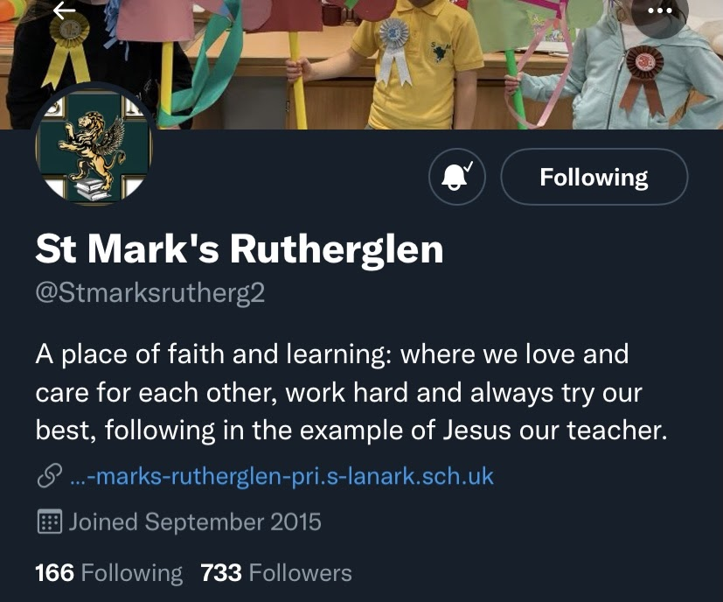
Reminders
Please remind all pupils that no toys should be brought from home on any occasion.
Playground equipment is provided at break and lunch and games/resources are provided for Golden Time.
Pupils should bring a water bottle every day for throughout the day in class. Please ensure this is plain water – not fizzy juice or diluting juice.
As a Health Promoting school we encourage healthy snacks e.g an apple or banana along with a drink of water or fruit juice. They are not allowed cans, fizzy juice or chewing gum.
We have some pupils with nut allergies, so please ensure no nut based products are brought to school.
Keep up to date with the class on the school app and twitter!

