Slide 1
Welcome to Primary 4

Slide 2
The Purpose of this Powerpoint…
Due to the current Covid 19 restrictions, we are unable to have Meet the Teacher in the normal way.
However, this Powerpoint will give you more information about your child’s life and education in school.
Become aware of class organisation and routines.
Learn some of the strategies we use to help your child learn.

Slide 3
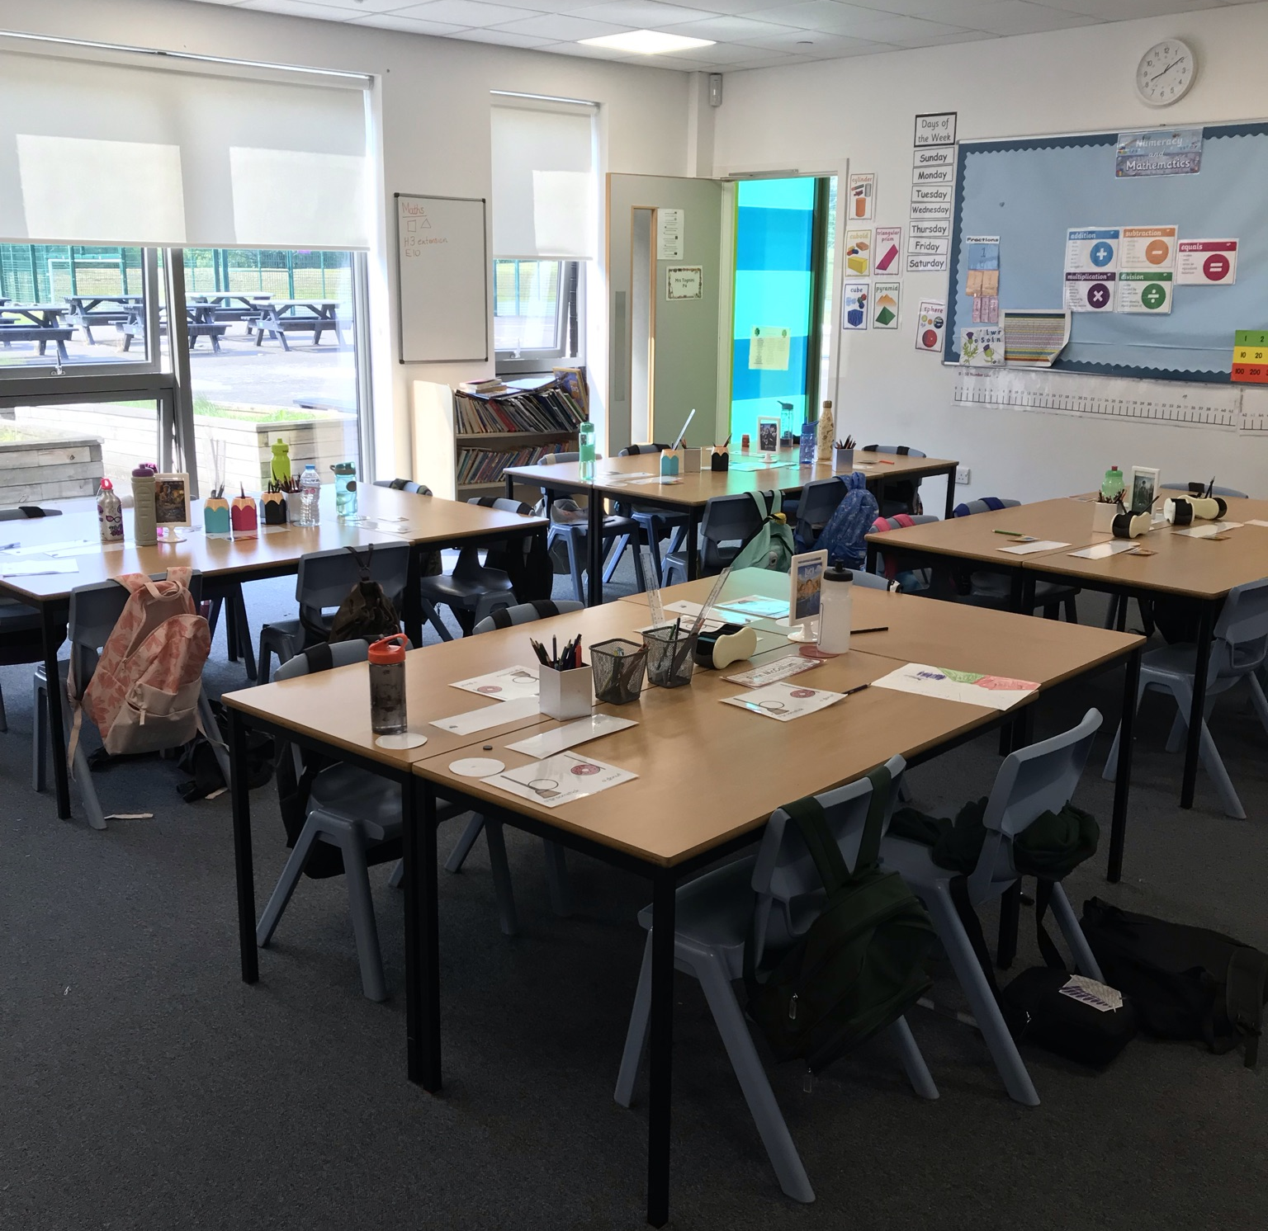
Classroom Layout The P4 Classroom desks in groups

Slide 4
Our Classroom
The children in Primary 4 have settled back into school very well.
Morning routine -
Hang jackets in the cloakroom and school bag over the back of their chair.
Place water bottle on circle on desk or leave in their bag.
Morning Prayer.
Wash hands.
Self register and order lunch and milk (if required).
Complete starter activity.

Slide 5
Hand washing
We are trying our best to keep the children safe and healthy when in school.
Children wash their hands at least 5 times a
day:
When they arrive into school
Before and after play time (if they have been out in the playground)
Before and after lunchtime (if they have been in the playground.
At other times when appropriate.

Slide 6
Promoting Positive Behaviour
Classroom award system
The St Mark’s Way
Gold Award – certificate sent home when achieved
Golden Time
St Mark’s Marvel

Slide 7
P.E. Days Tuesdays and Friday
This Photo by Unknown Author is licensed under CC BY-NC-ND
In relation to the class Interdisciplinary Lessons on Explorers, the children will be learning basic orienteering.
PE. can now be in inside and outside although it will be outside when we can.
Please ensure your child comes to school in polo shirt on a gym day and with appropriate shorts and indoor shoes that they can change into.
Please can you ensure your child has the appropriate jacket and shoes for these days.
Please also ensure that no jewellery is worn on P.E days and if your child cannot take their earrings out then please cover them in clear tape. This is for health and safety.
Please ensure your child’s name is on all of their belongings.
This Photo by Unknown Author is licensed under CC BY-SA

Slide 8
Homework
All children have access to a Google Classroom account.
The homework tasks will be a mixture of phonemes, reading, and numeracy to consolidate their learning in class.
Jotters will be sent home for the work to be completed if it can’t be ‘handed in’ on Google Classroom.
Can you please encourage your child to do independent reading every night!
After 25 minutes of homework - STOP!!!
If you are having difficult accessing Google Classroom, or for any reason do not have internet access, please get in touch to let us know and will make other arrangement.

Slide 9
Numeracy
In class….
Variety of resources used – focus on developing skills and knowledge
Class warm up
Counting in stations of times tables
Oral Counting: 2s, 5s, 10s Whole class games
Floor games
Times Table bingo
Active games/approaches
Independent follow up tasks
Educational games on the Chrome Book
Education City

Slide 10
Numeracy
Ideas for home…….
Money: counting out and giving change from £1 working upwards.
Time: o’clock, half past, quarter past and quarter to, 5 minute intervals
Fractions: halves and quarters
2, 3,4,5 and 10 times tables – saying full table not just answers. Cubes and Spheres groups.
2,5 and 10 times tables – pyramids group.
Counting to 100 – simple addition and subtraction within 100.
Online Games: Education City – username/password given to children. Top Marks, Doorway
Online, Sparklebox – some interactive games

Slide 11
Phonics
Phonological awareness and Spelling – North Lanarkshire Active Literacy Programme, phonics and common words.
Active approaches – games, magnetic letters, Five finger rule, multi sensory spelling activities and outside activities.
Blending sounds to attack words.
Recognising the sound a letter makes as well as its name.
Look and say common words at this stage and encourage children to know how to spell them.

Slide 12
Reading
Reading books – Banded Reading depending on reading ability.
Active approaches –word matching and sentence building.
Word attack strategies –on wall and reinforced daily.
Comprehension activities for understanding of the text.
Skim and scam activities.
Dictionary activities

Slide 13
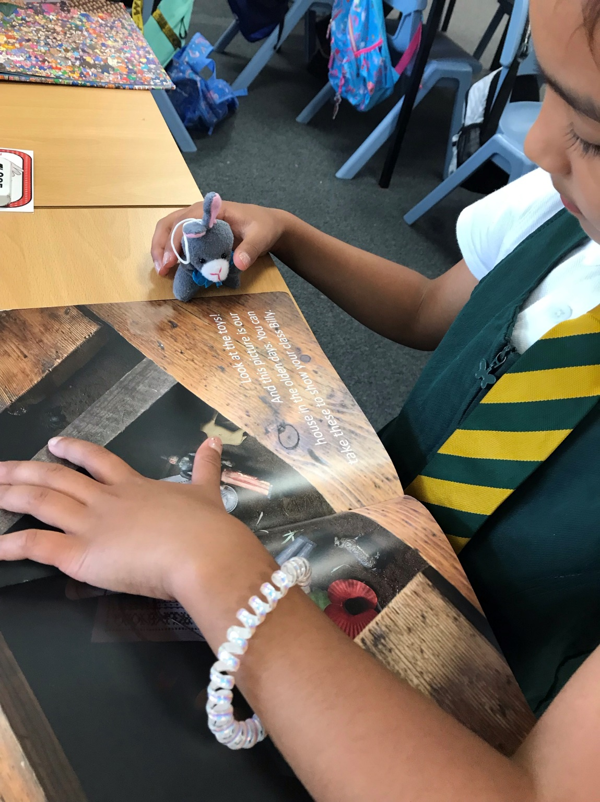
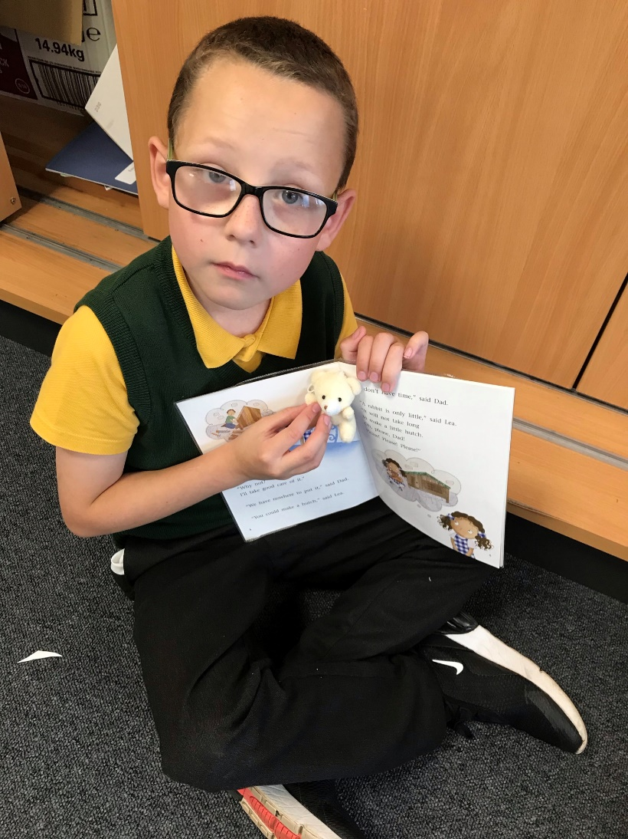
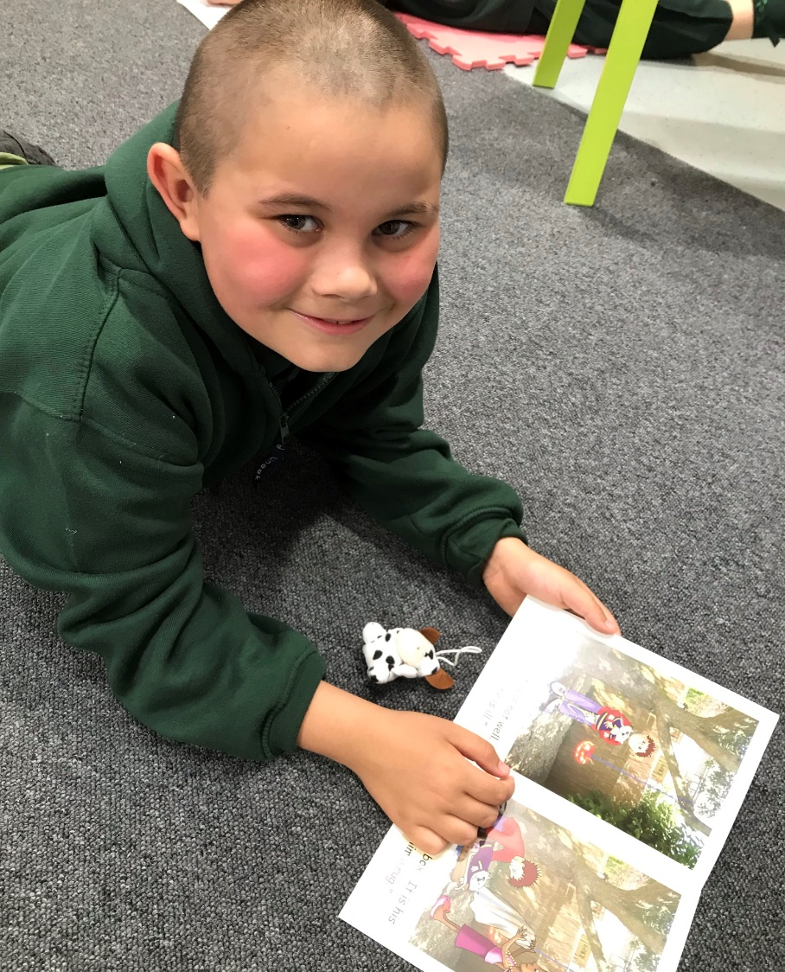
The children were introduced to their reading buddy. A little soft toy that they can read out loud to. Everyone loves their reading buddies.

Slide 14
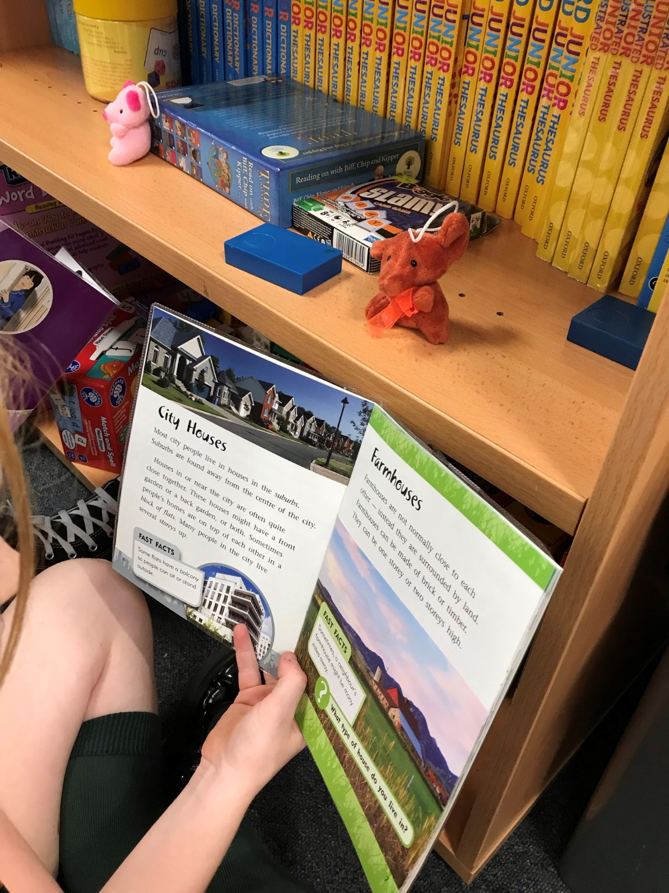
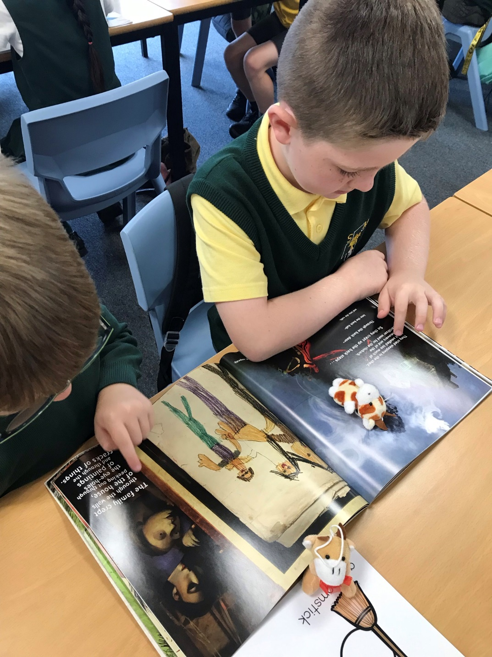
Photos of our Reading Buddies

Slide 15
Writing
Encourage correct letter formation – very important in P4 as children move towards joining letters
Writing in a jotter every day for a variety of purposes: spelling, reading, personal, across the curriculum
Success Criteria – child involvement
Weekly story writing lesson – personal, imaginative and functional
Star Writers awards
Term 1 - we are focussing on writing descriptions.

Slide 16
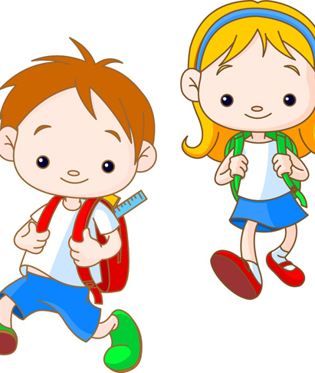
Reading Books
Please can you make sure that your child’s reading book is brought to school with them every day.

Slide 17
Health and Wellbeing
In Health and Wellbeing lessons, the children have been discussing different emotions and colours to go with them.
In the promotion of wellbeing, in lessons about resilience the children have been using BOUNCEBACK and thinking about different scenarios that they have found difficult
The children will be learning about the importance of talking and listening. These skills have been used when ‘Talking and Listening’ board games.

Slide 18
Art with Mrs Hughes The children have been learning about the Spanish architect Antoni Gaudi. Here is a wall display of their work.

Slide 19
A few points to remember: Please remember that due to the current climate, children are not allowed to bring toys in from home. Children are encouraged to bring a healthy snack e.g an apple or banana along with a drink of water or fruit juice. As a Health Promoting school children are not allowed cans, fizzy juice or chewing gum. We have some pupils with nut allergies, so please ensure no nut based products are brought to school. Please remember that there is regular communication through the school app and Twitter so it would be great if you could download these if you haven’t already. @Stmarksrutherg2

