Slide 1

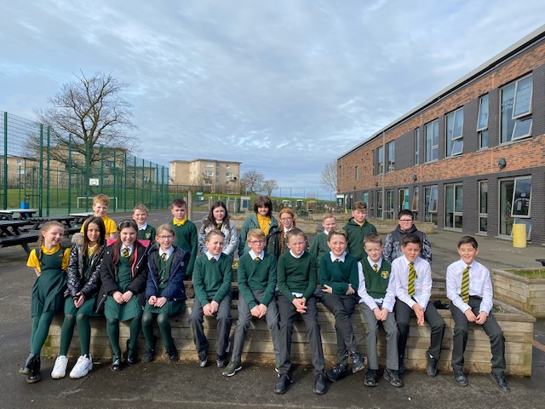
Welcome to P7!

Slide 2

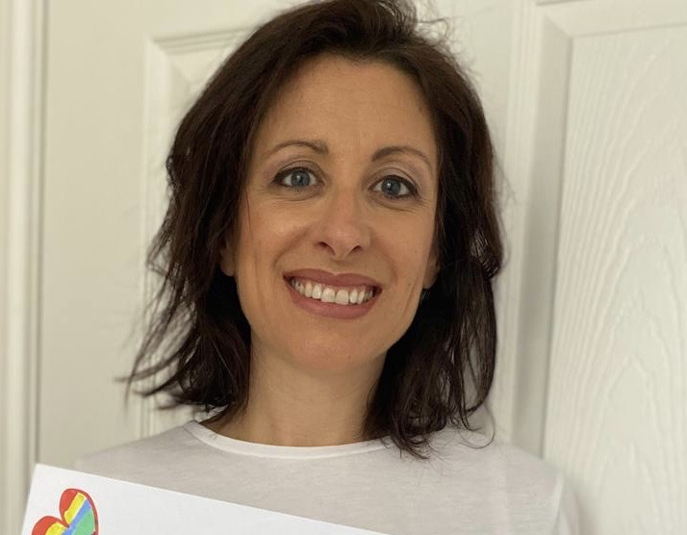
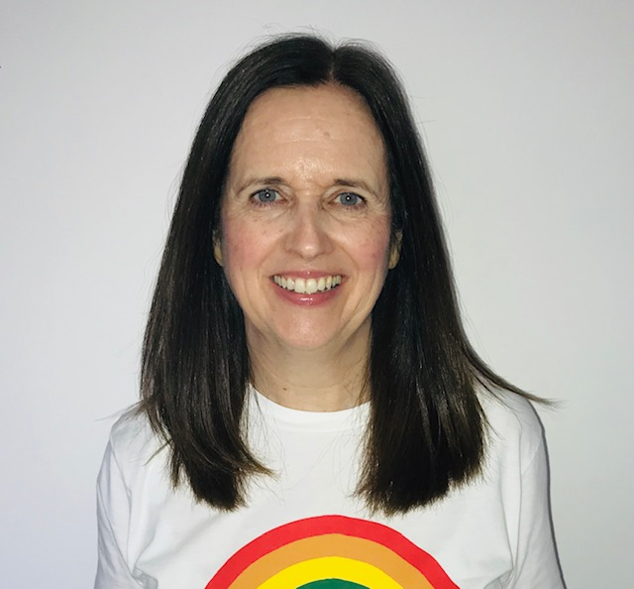
The Purpose of today…
Meet your child’s teachers.
Become aware of class organisation and routines.
Learn some of the strategies we use to help your child learn.
Mrs Linskey →
← Mrs Sutherland

Slide 3


Our Classroom
Morning routine -
Jackets and bags are put into the cloakroom.
Water bottles to be placed on desks.
Morning prayer.
Handwashing group by group.
Register, lunches and plan for the day
Starter activity/mental maths.

Slide 4

Promoting Positive Behaviour
RRS – Ready Respectful Safe.
Recognition Board.
Positive Notes Home
St Mark’s Way- the children all begin on Green, ready to learn, and can then progress up to Gold or move down to Red. Children complete a Lunchtime Reflection with SLT if on Red giving them a chance to reflect on their behaviour and how they could change it. All children start afresh each day on Green.
Group Points- the winner of the week gets a treat from the prize box.

Slide 5







Numeracy
In class….
Interactive warm up
Revision of addition, subtraction, multiplication and division.
Active games/approaches: games on C-touch, partner games at desk, whole class games.
Independent follow up tasks – working from a variety of resources e.g. SHM, TJ Maths, HAM
Mental Maths
RM Easimaths.

Slide 6
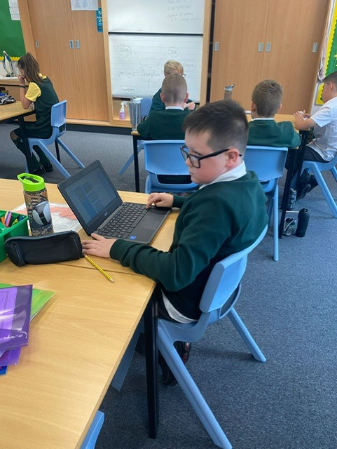
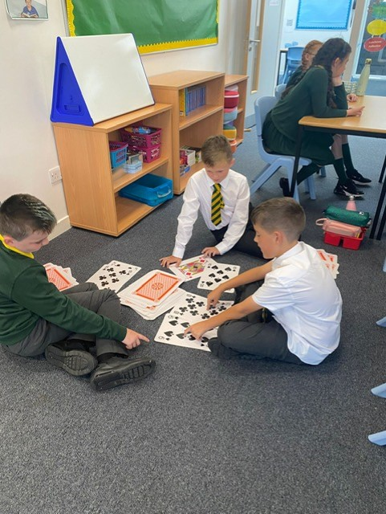
Numeracy
In class….

Slide 7
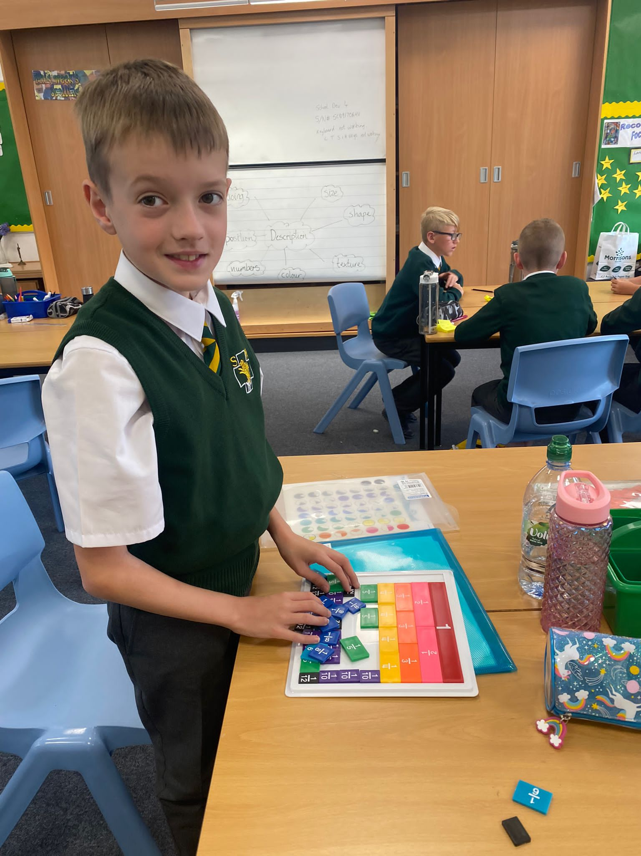
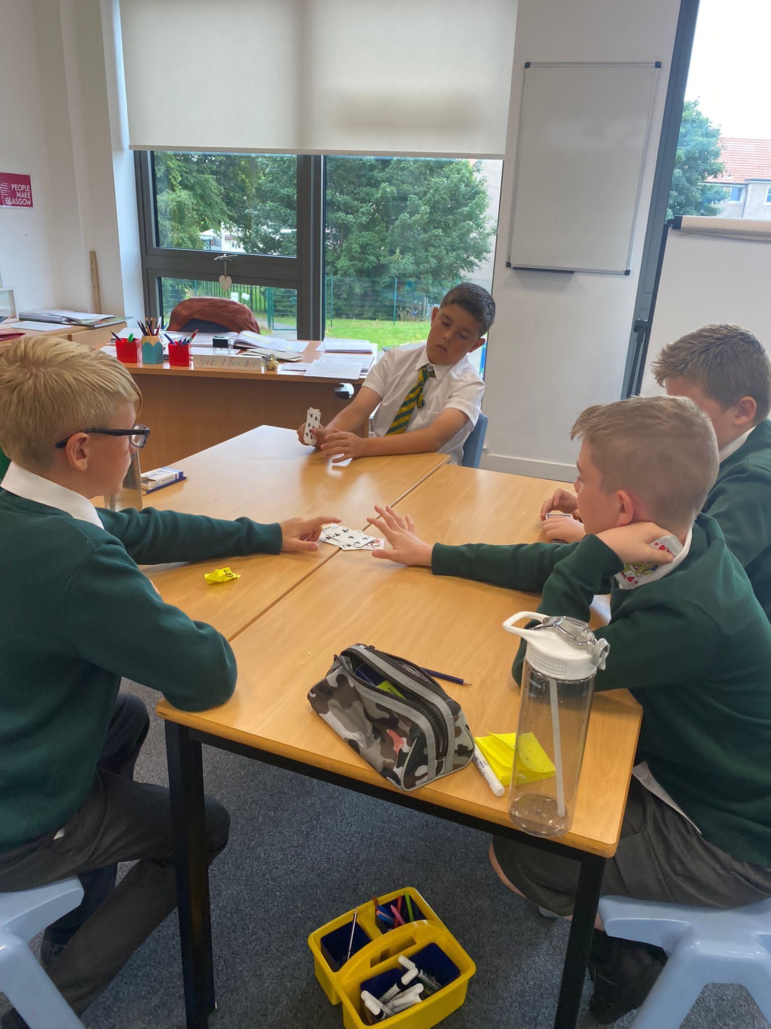
Numeracy
In class….

Slide 8
Numeracy
Ideas for home…….
TOPMARKS website for interactive games.
Education City
Times Tables practise – oral reciting
Shopping – using and counting money, giving change.
Time: o’clock, half past, quarter past and quarter to, 5 minute intervals, 1 minute intervals.

Slide 9



Reading
Reading books – Literacy World/Rapid Readers
Whole Class and group tasks
Reciprocal Reading
Pie Corbett class novel ( This term, “Fireweed”)
ERIC time
Teacher led reading
Comprehension - seen and unseen tasks
At home- read together, simple questions, find/ match words.
Find ‘WOW’ words.

Slide 10



Spelling
Phonological awareness and Spelling – North Lanarkshire Active Literacy Programme, phonics and common words
Active approaches – games, magnetic letters, Five Finger Rule, multi sensory spelling activities.
Blending sounds to attack words
Doorway Online Speller

Slide 11


Writing
A range of genres, often topic related.
Success Criteria for each lesson displayed at the top of work highlighting to the children what is expected in each piece of work.
Using ICT.
VCOP – starter activity & display.
Star Writer

Slide 12
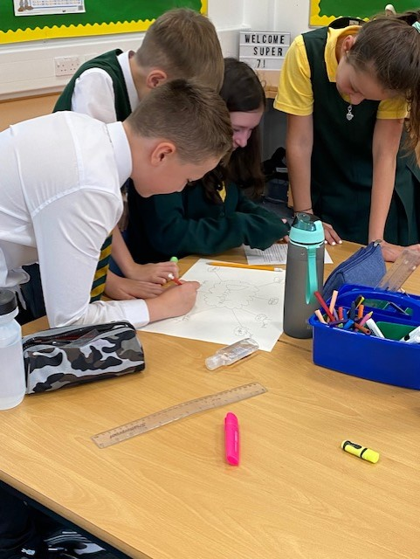
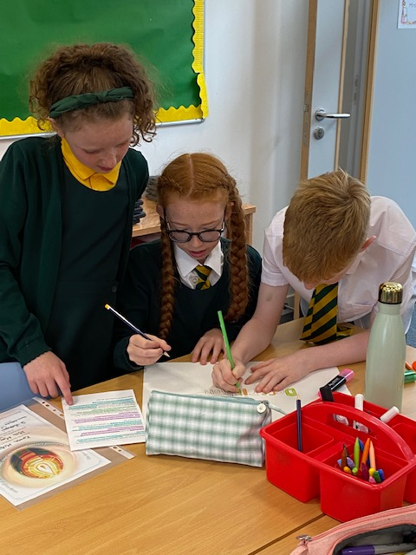
Literacy

Slide 13
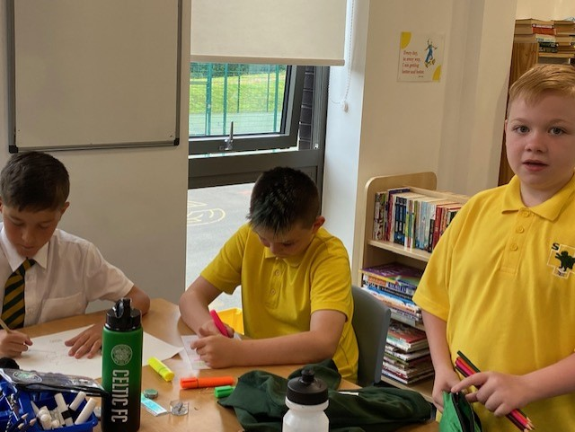
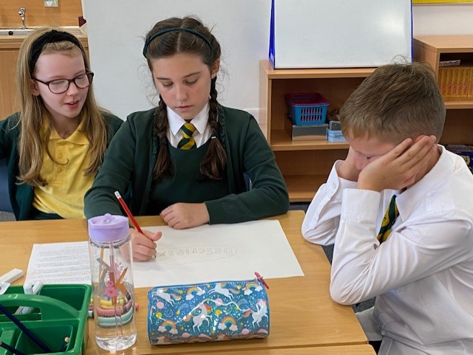
Literacy

Slide 14
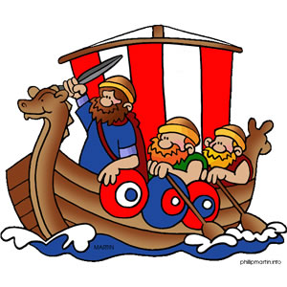

Topics
SHANARRI – rights & responsibilities of the child. Linking to class rules.
Divided City (Sept - Nov)
Christmas Enterprise (Nov – Dec)
Scotland (Jan – Feb)
World War Two (Feb –April)
Reciprocal Reading, text to be chosen by class.
(Apr-Jun)

Slide 15



PE
PE will take place indoors and outdoors this year. Our PE days are Tuesday and Friday.
Any Jewellery should be removed for PE days. Earrings should be covered with clear tape if they cannot be removed
Children should have plenty of water with them on PE days. Water is kept up in the classroom for the children returning from PE. If we are outside and it’s a sunny day they take their water with them.

Slide 16
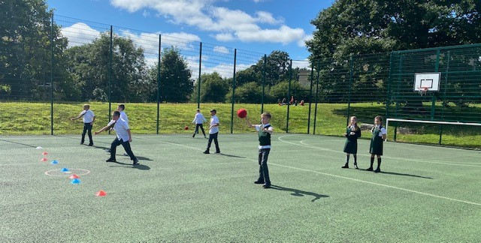
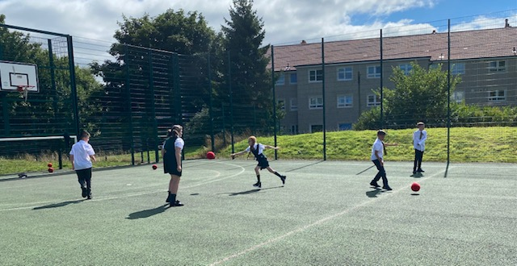
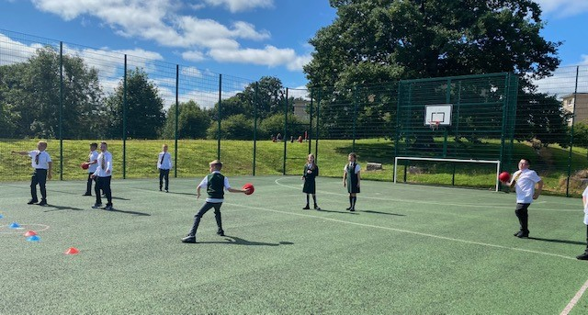
PE

Slide 17
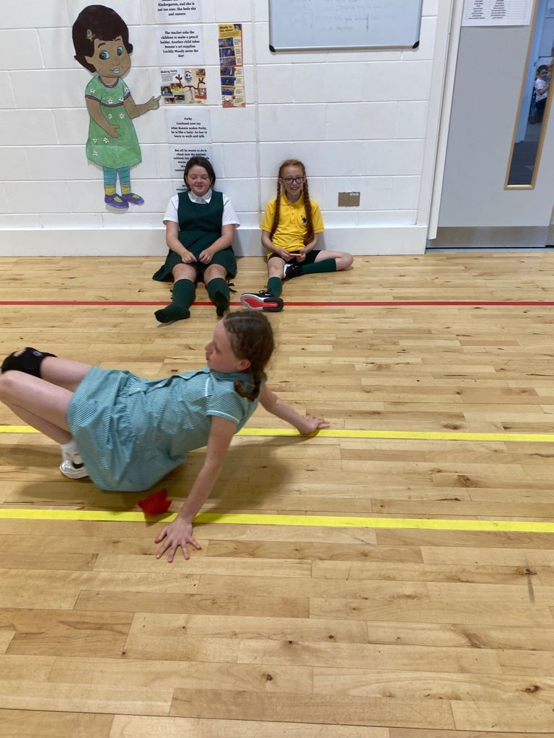
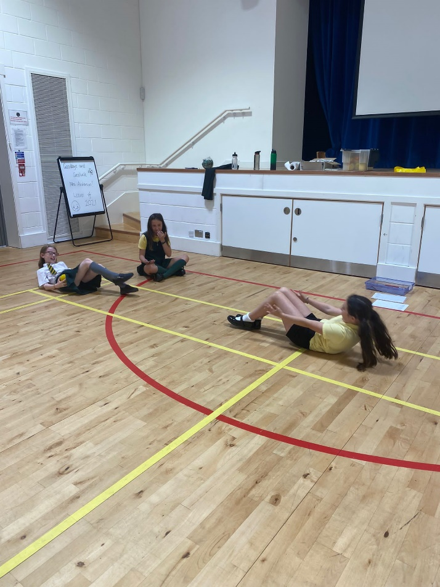
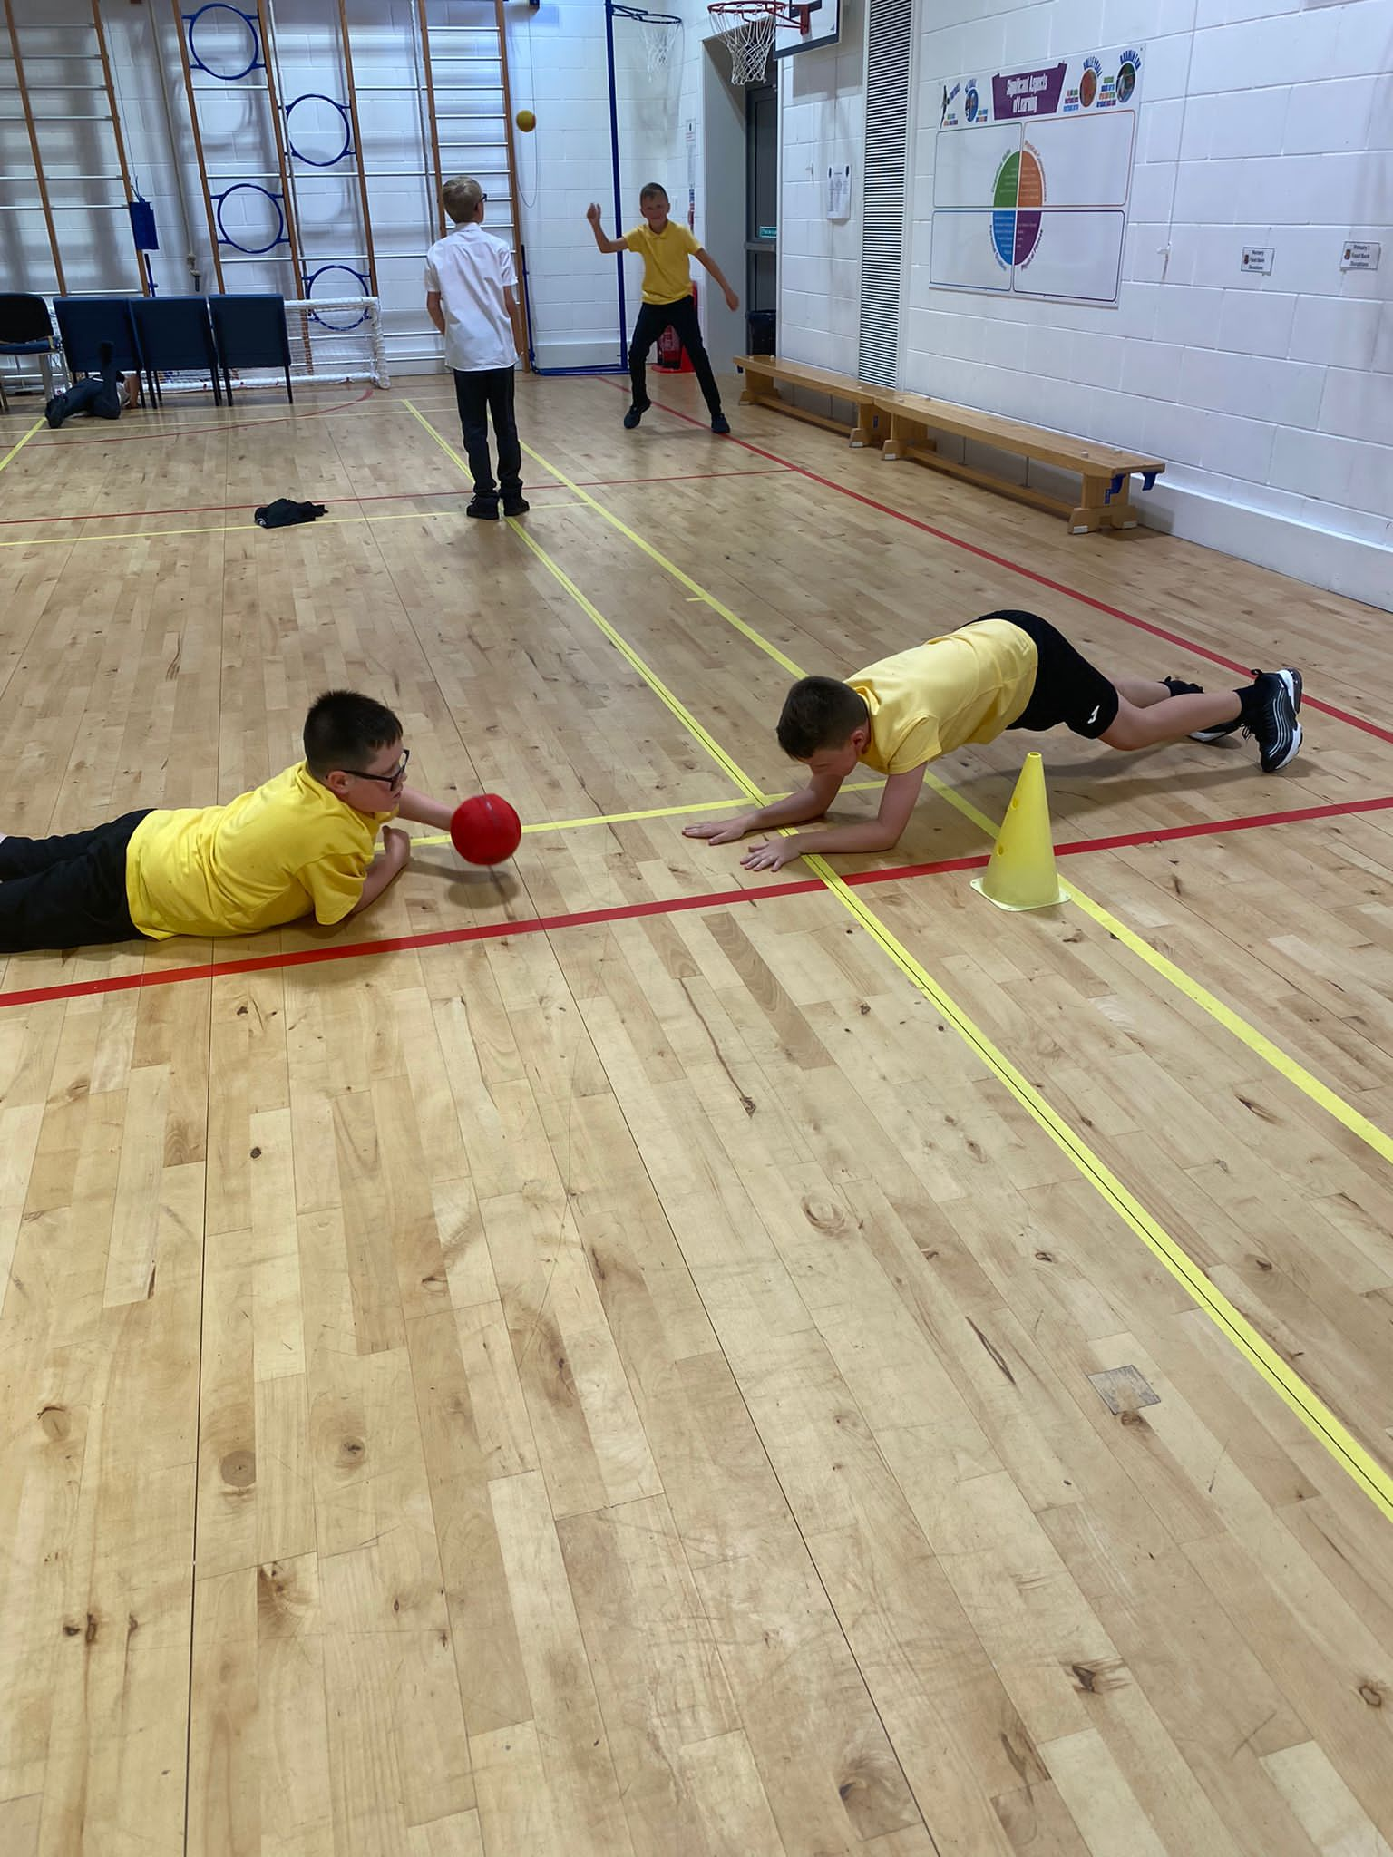
PE

Slide 18
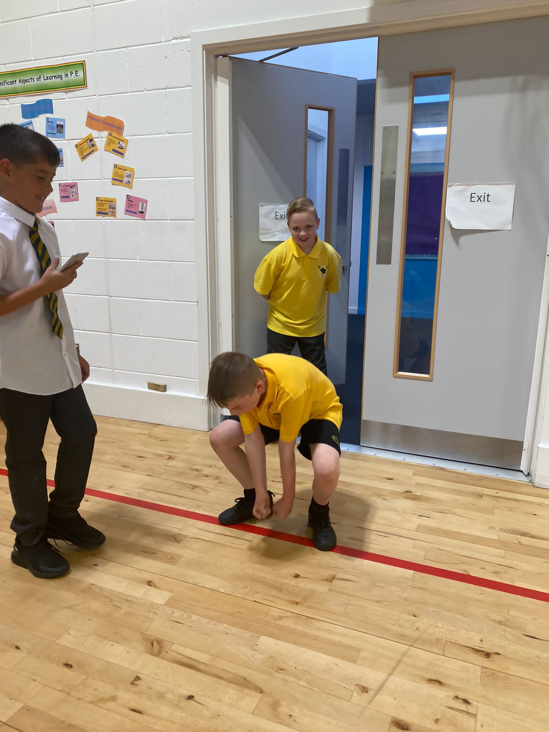
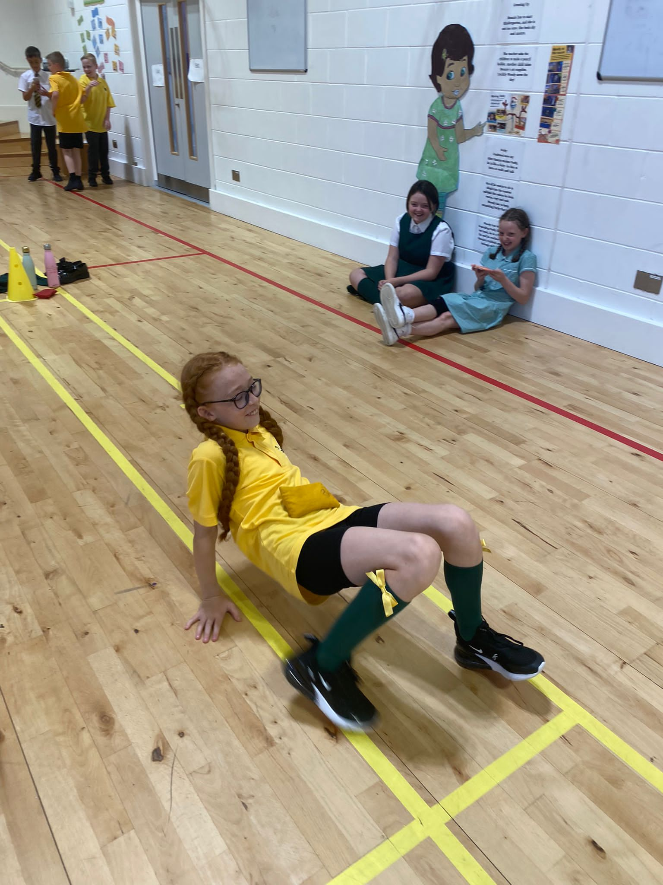
PE

Slide 19
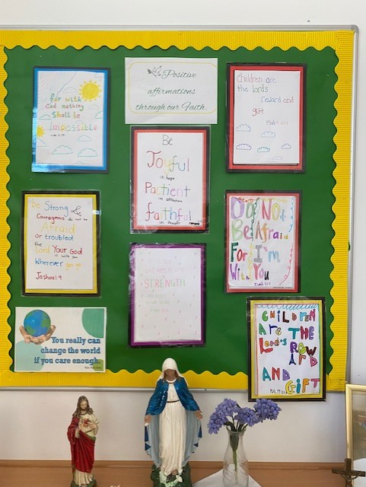

RE
The children looked
through the Bible
and found
Positive Affirmations
through our Faith and
displayed them in class.

Slide 20
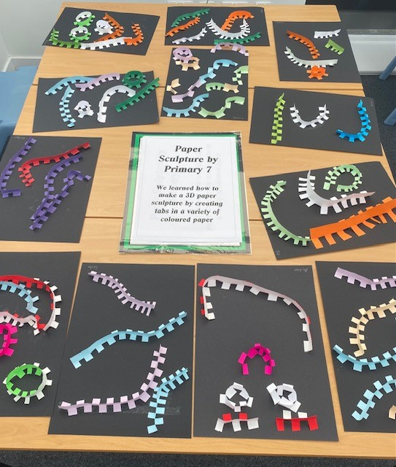
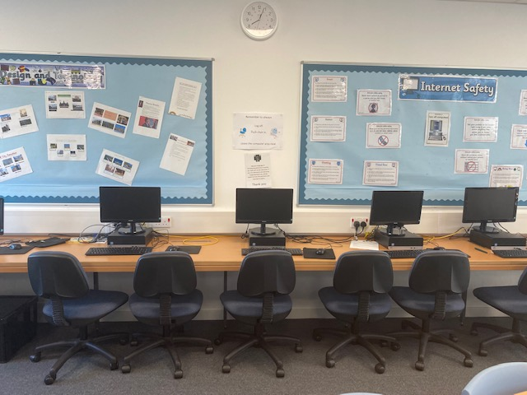
ART
TECHNOLOGY

Slide 21


Homework
After 25 minutes, STOP!!!
Will change from week to week.
Google Classroom and Education City Tasks
Mental Maths
Written Maths
Spelling/Active Spelling
Reading/Comprehension
Topic research

Slide 22

A few points to remember:
Please remember that due to the current climate, children are not allowed to bring toys in from home.
Children are encouraged to bring a healthy snack e.g an apple or banana along with a drink of water or fruit juice.
As a Health Promoting school children are not allowed cans, fizzy juice or chewing gum.
We have some pupils with nut allergies, so please ensure no nut based products are brought to school.
Please remember that there is regular communication through the school app and Twitter so it would be great if you could download these if you haven’t already.
@Stmarksrutherg2

Slide 23

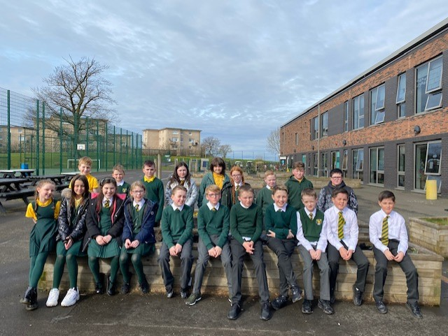
Team P7

