Slide 1

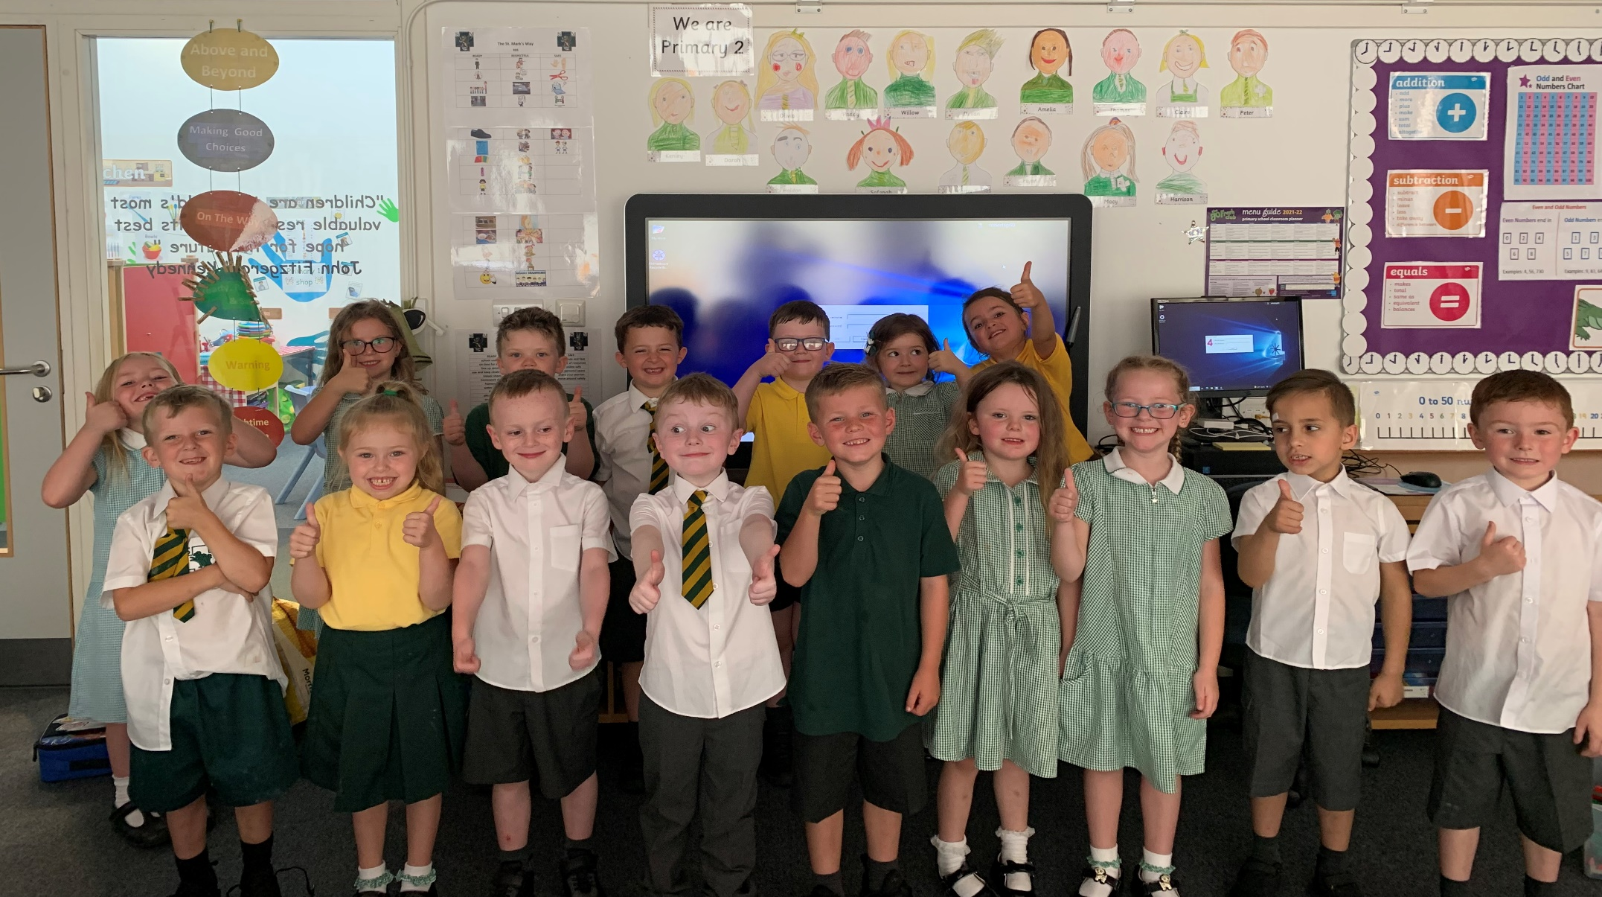
Welcome to Primary 2!

Slide 2
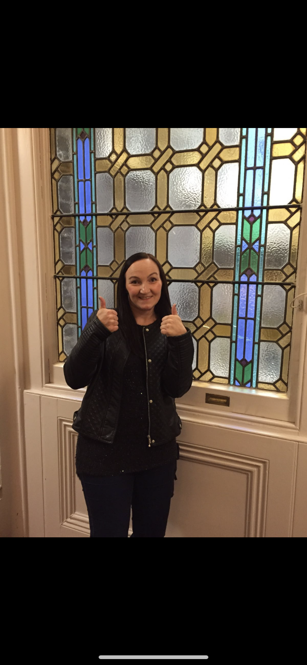
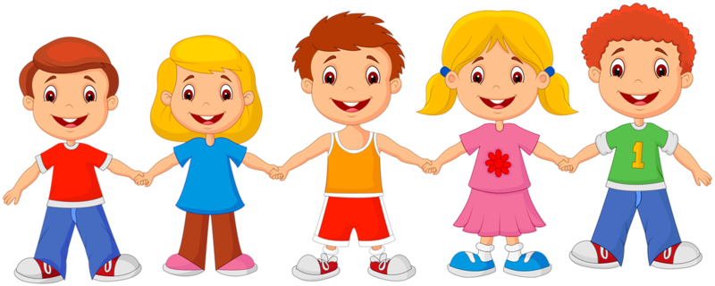
The Purpose of this Presentation…
To meet your child’s teacher
(Sorry it can’t be in person)
Become aware of classroom organisation and new routines since returning to school.
Get an insight into what classroom life is like.
Be assured that your child is learning and is safe and happy.

Slide 3
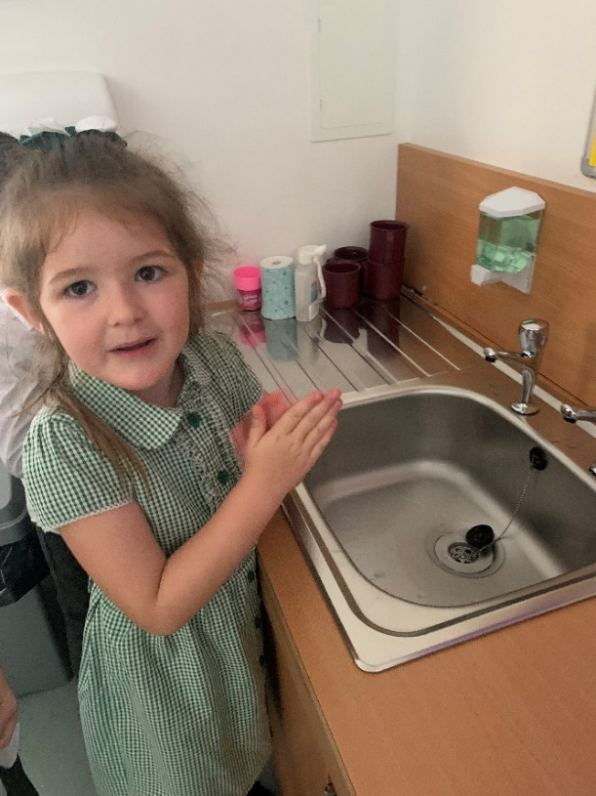

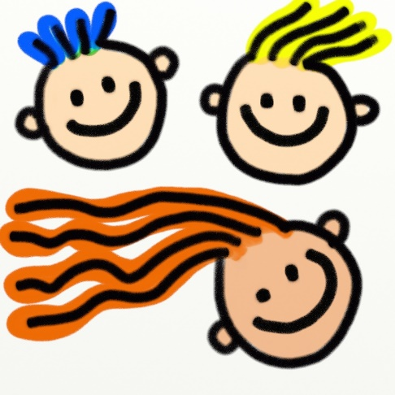
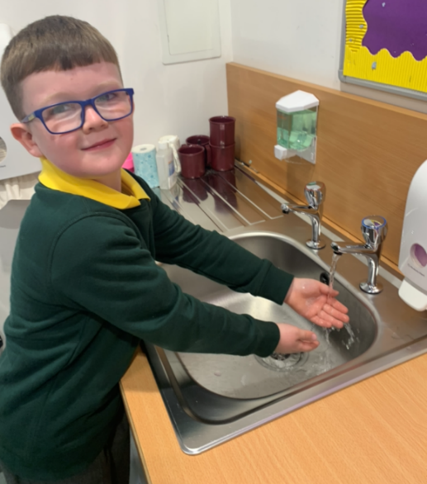
Our Classroom
We still have lots of safety measures in place to help keep us all safe.
Our P2 classroom is our safe bubble.
We still try to keep a safe distance as much as possible from other adults and children not in our class bubble.
We wash and sanitise our hands regularly
We keep smiling!

Slide 4

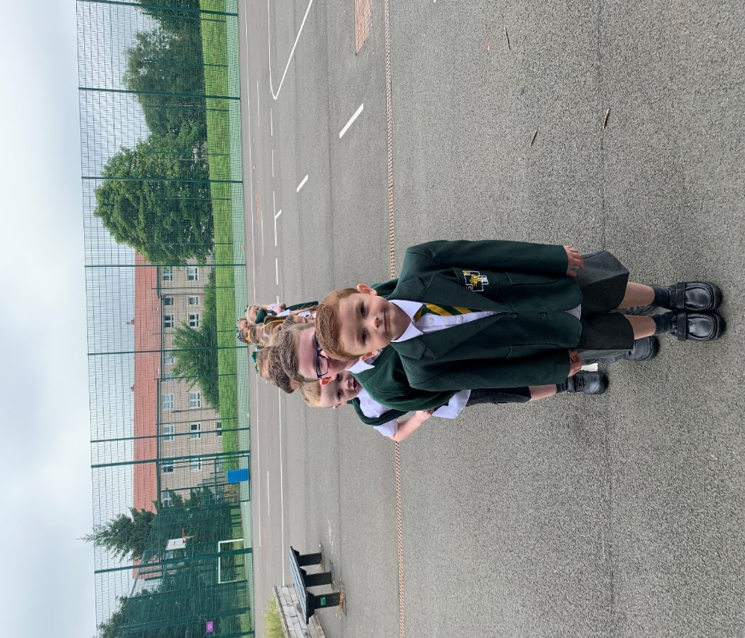
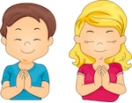
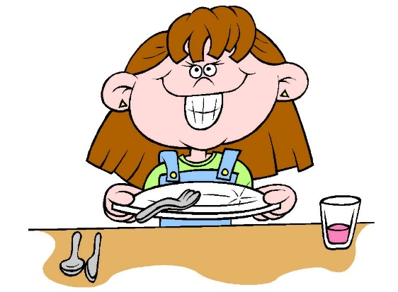
Our Classroom
Morning routine –
Hang jackets and school bag in the cloakroom
and bring water bottles into the classroom.
Handwashing – This is repeated before and after each break too.
Morning Prayer
Water bottles on names on desk
Register and lunches
Hand in homework (Friday)

Slide 5


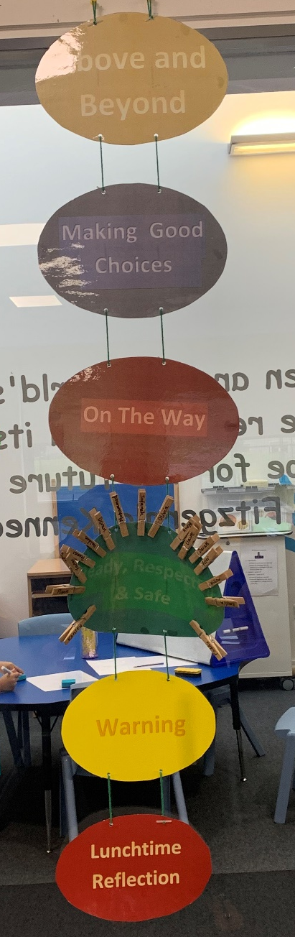



Promoting Positive Behaviour
The St. Mark’s Way
Class Charter
Personal Points & weekly winner
Group points & Group of the Week
Star of the Day Award
Star Writer Awards each week
St Mark’s Marvels
Head Teacher Awards
Golden Time
This Photo by Unknown Author is licensed under CC BY-SA-NC

Slide 6
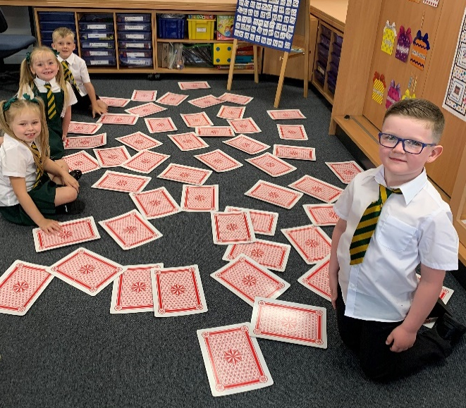
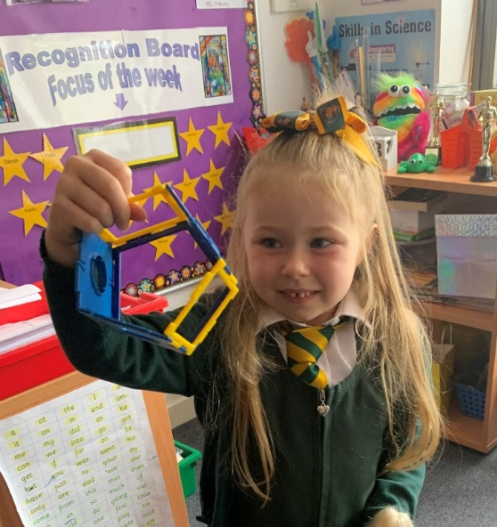
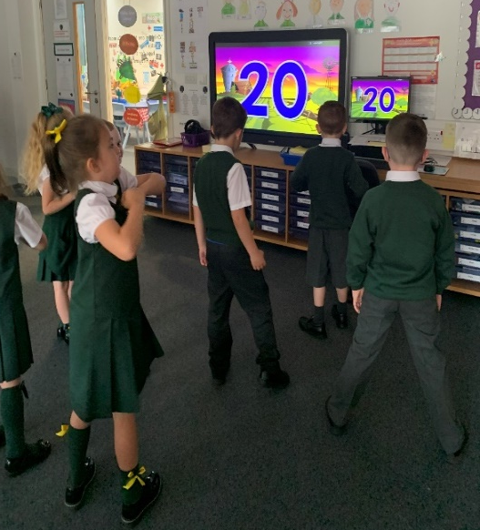
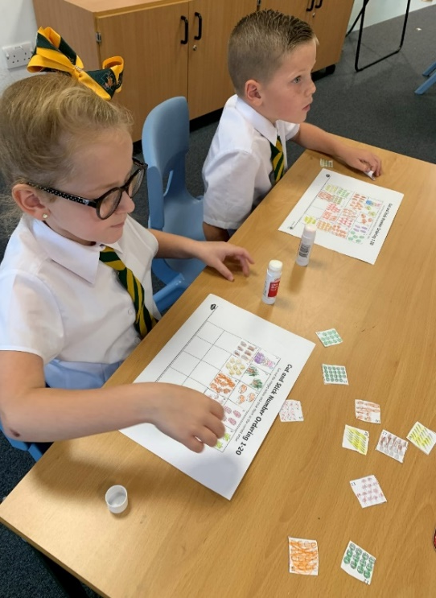






Numeracy
Lots of Revision
Lots of interactive activities and games
Number work: counting aloud, numbers before, after, in-between, ordering, sequencing, patterns, number names, addition & subtraction
Using concrete materials
Using Technology/I-Pads
Independent follow up tasks
Outdoor Learning

Slide 7
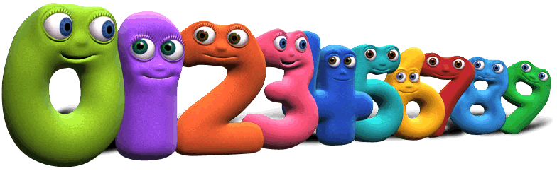

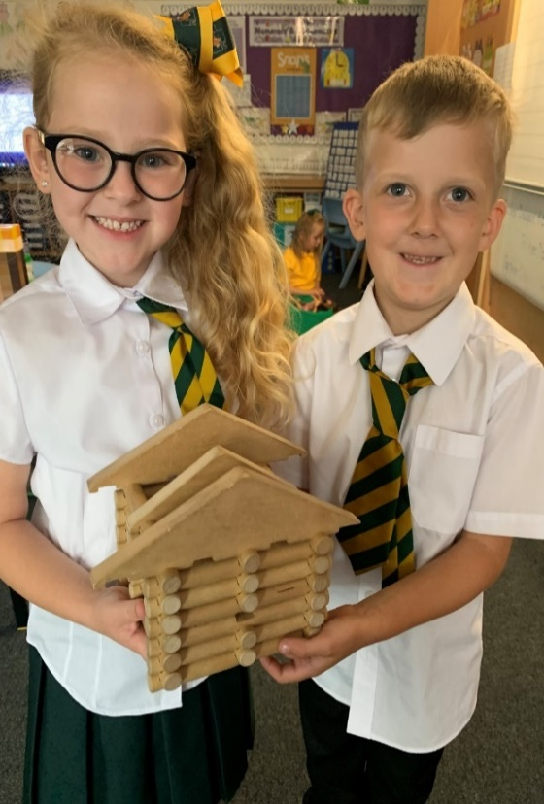

Numeracy
Some ideas for home…….
Count, sort, order numbers/objects.
Time, days of week and months of the year.
2D and 3D shape.
TOPMARKS website for interactive games
Education City
#

Slide 8




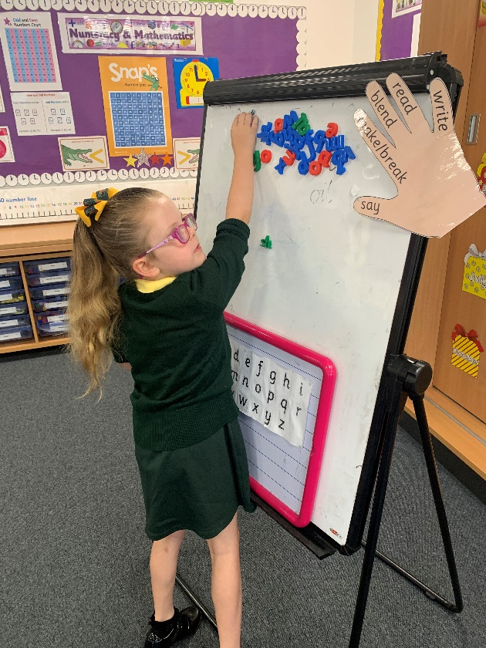
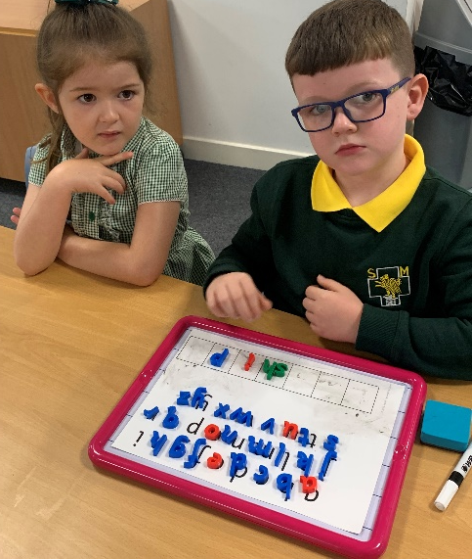
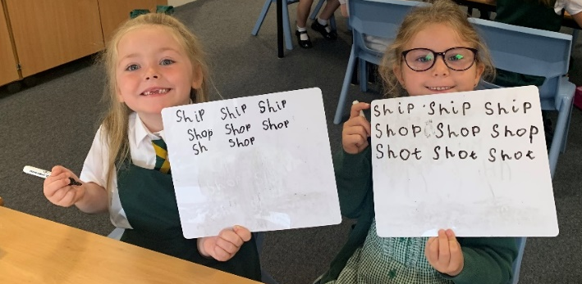
Literacy
Phonemes
Revision of initial sounds
Phonemes and Common Words
Weekly sounds - children will learn to read
and spell a new phoneme each week
Active approaches – games, magnetic letters, whiteboards, show me boards, interactive tasks
Five finger rule
Blending sounds to attack words
New common words every week
Use of Technology/I-Pads

Slide 9



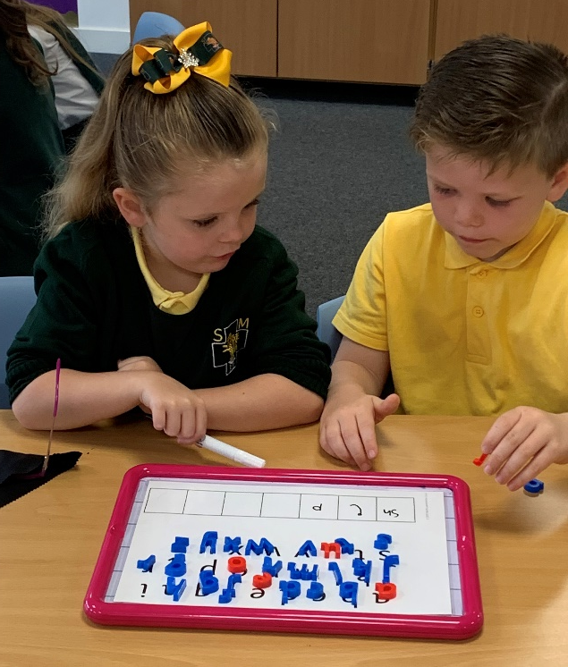
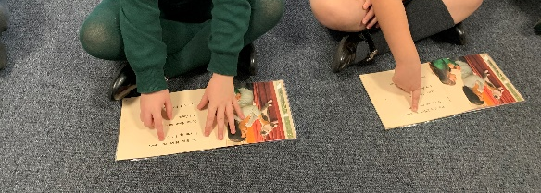
Reading
Common words / Phoneme - please practise every night
Reading books – weekly
Reciprocal reading
Class Library and School Library/Reading Cloud
Pie Corbett Class books – currently reading ‘Animal Stories’
E.R.I.C. Time (Everyone Reading in Class)
Active approaches –word
matching and sentence building
Word attack strategies
Games and interactive activities and tasks

Slide 10
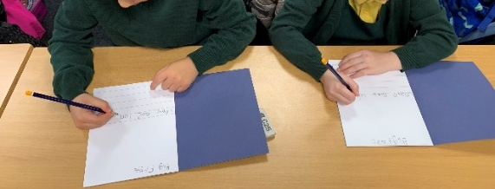
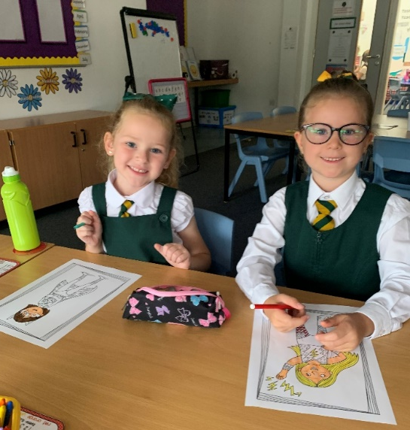

Writing
Pencil control
Encourage correct letter formation with letters resting on the line – lower and upper case
Writing simple sentences as a class and independently
Capital letters and full stops
Use phonemes and common words to support writing
Use tricky word book and class dictionary
Story Writing – covering various genres
Star Writer’s Award
Teacher and self/peer Assessment

Slide 11

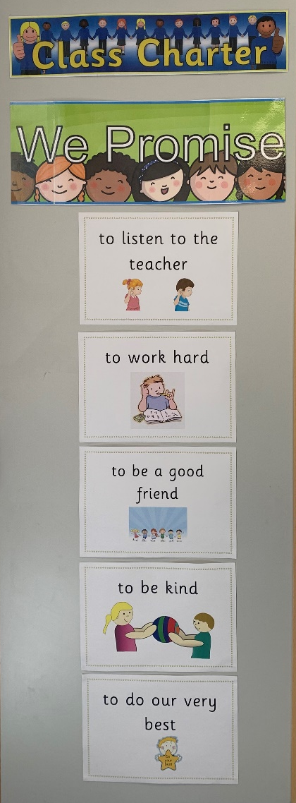
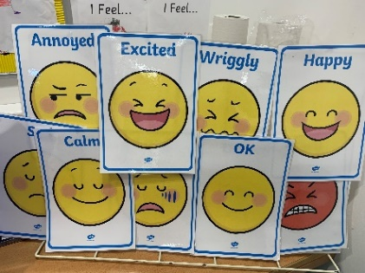
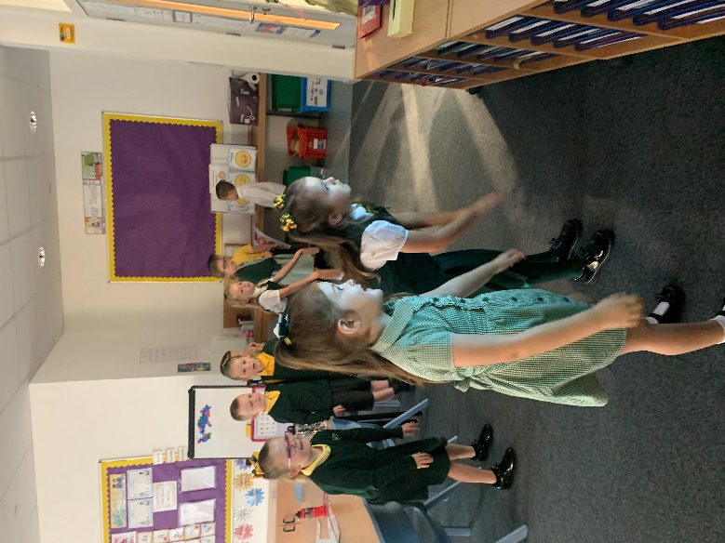
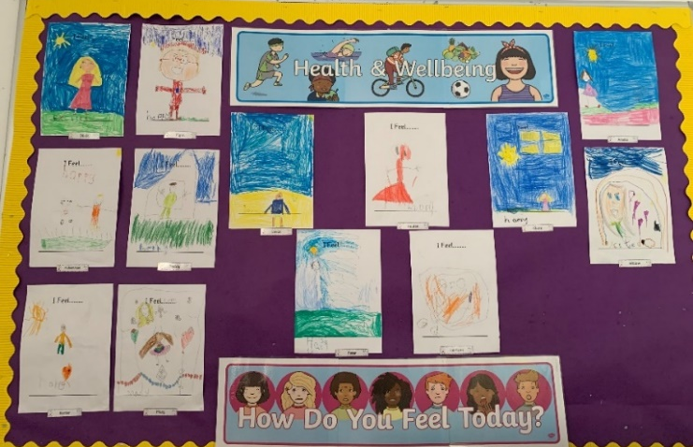

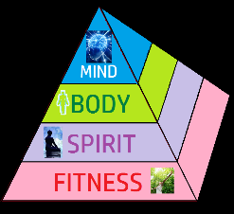

Health and Wellbeing
Bouncing Back
Circle Time – Feelings, changes, friendships, emotions, helping one another, resilience, keeping safe.
Talking and Listening
Blether Stations
Discussion Groups
How Do I Feel Today?
Class Worry Monster
Stories
Yoga/Meditation
Calming/quiet area
This Photo by Unknown Author is licensed under CC BY-NC

Slide 12
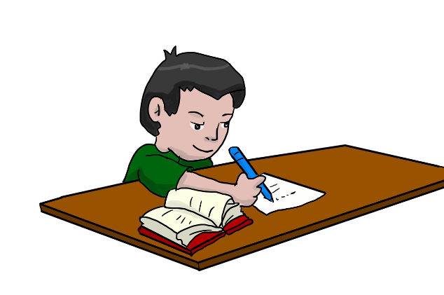


Homework
Homework is given out on a Monday and should be returned to school on the Friday.
Reading books should, however, be brought to class each day
Built in Revision
Reading book, common words chart and phonemes.
Number worksheet/activity
Literacy worksheet/activity
Other subject areas will also be added from time to time/special projects and even class competitions!
Google Classroom may also be used.

Slide 13

Points to Remember
Our school day in P2 school day is 9am – 3pm
We have designated play areas each week for the moment. The children remain with their own class but will have a change of area/environment each week.
Our P.E days are Monday and Wednesday. Polo shirts can be worn on these days. No jewellery should be worn and clear tape should be used to cover earrings if these can’t be removed.
Encourage independence with clothing (zips, buckles etc)
Water bottle – please provide – only water in these please
Lunch menu – please look in advance
We have children in school with nut allergies – please ensure no nut based products are brought to school
Don’t forget to check Twitter @Stmarksrutherg2 and the
school app for photos and updates
Any queries at all, please do not hesitate to get in touch.

Slide 14

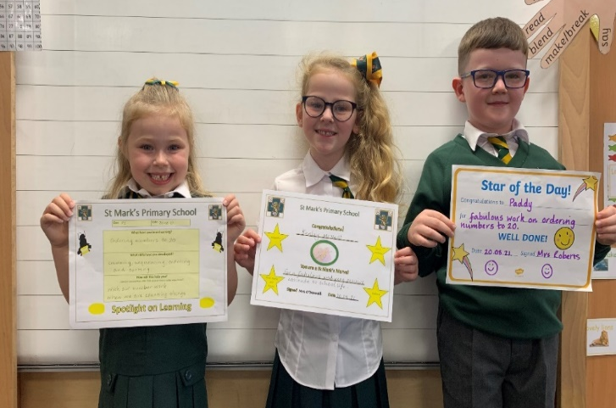



Mini Assembly
On a Friday afternoon we will be holding a mini assembly in class
A St. Mark’s Marvel will be chosen and the lucky boy or girl will have tea with the head-teacher the following week.
Marvellous Moments from out-with school will also be shared e.g. medals won at clubs, riding a bike or just doing something great!
We will also share a little snippet of something we have been learning that week in class with our spotlight on learning.
In addition to this we will also have our personal points winner, our group of the week and our star of the day.
Lots of rewards for lots of hard work!

Slide 15
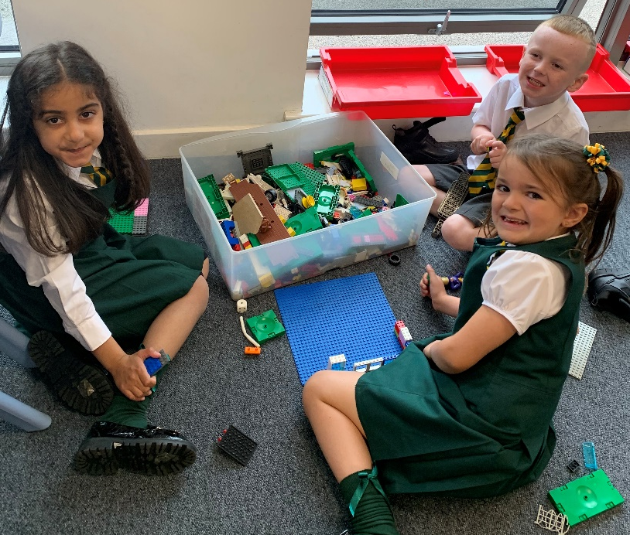
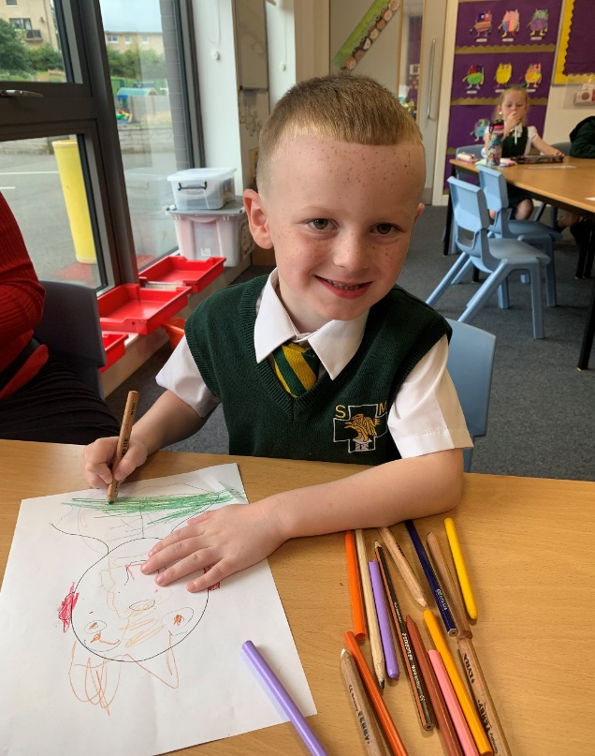
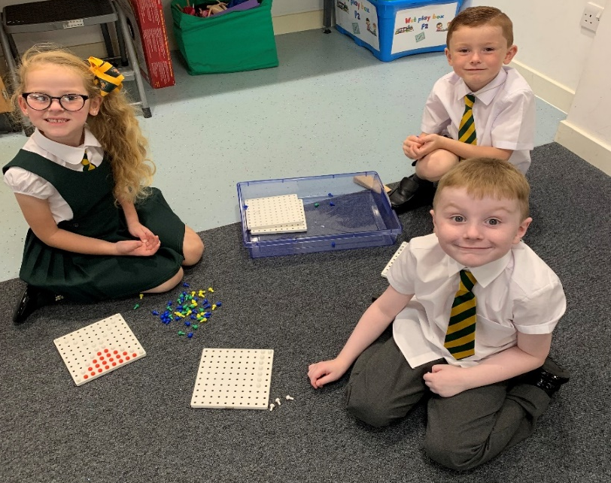
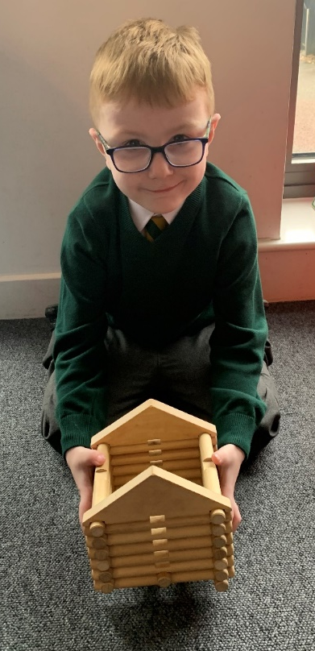
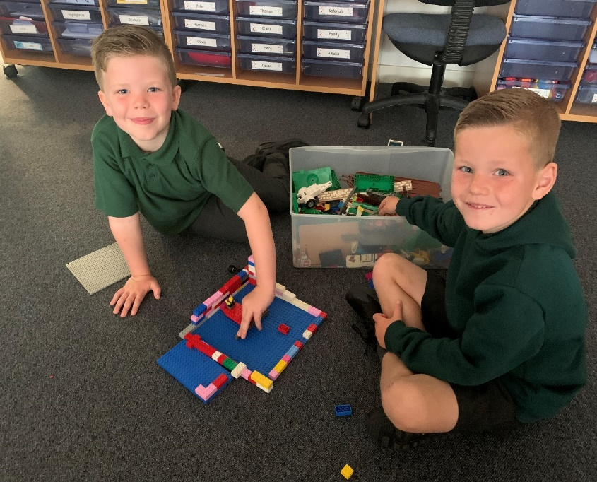
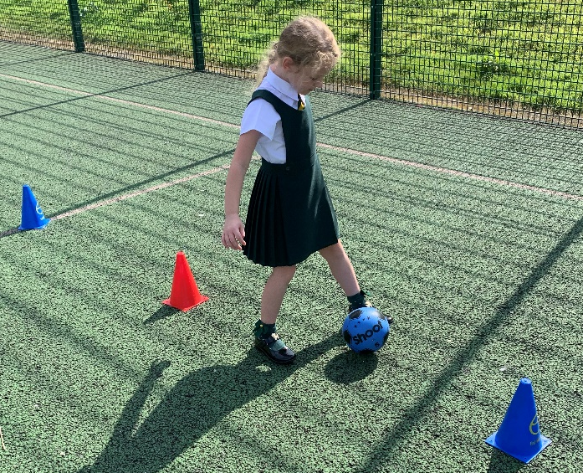

A Peek At P2

Slide 16
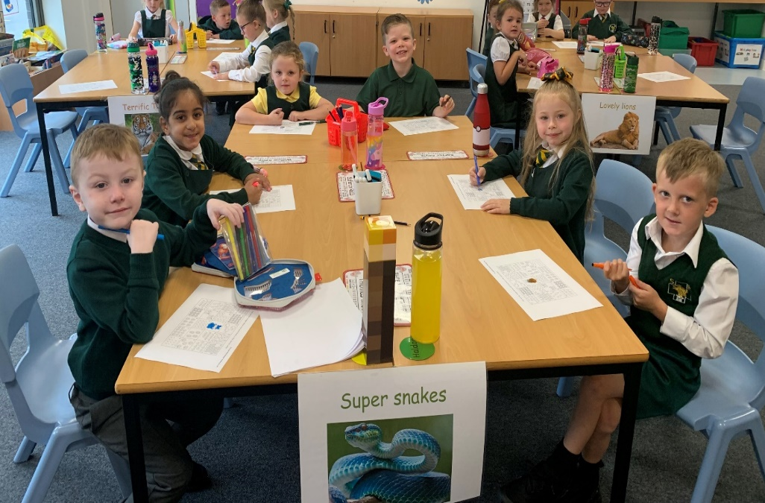
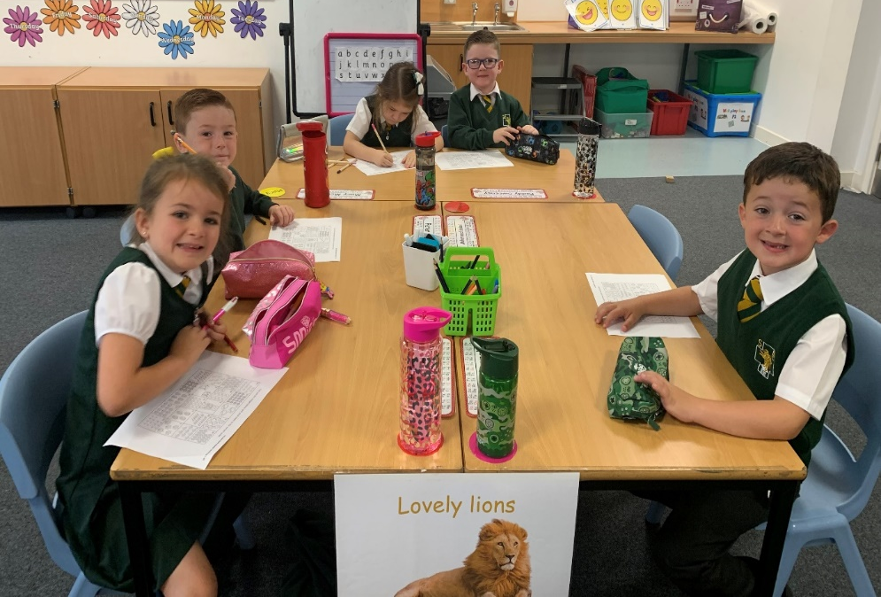
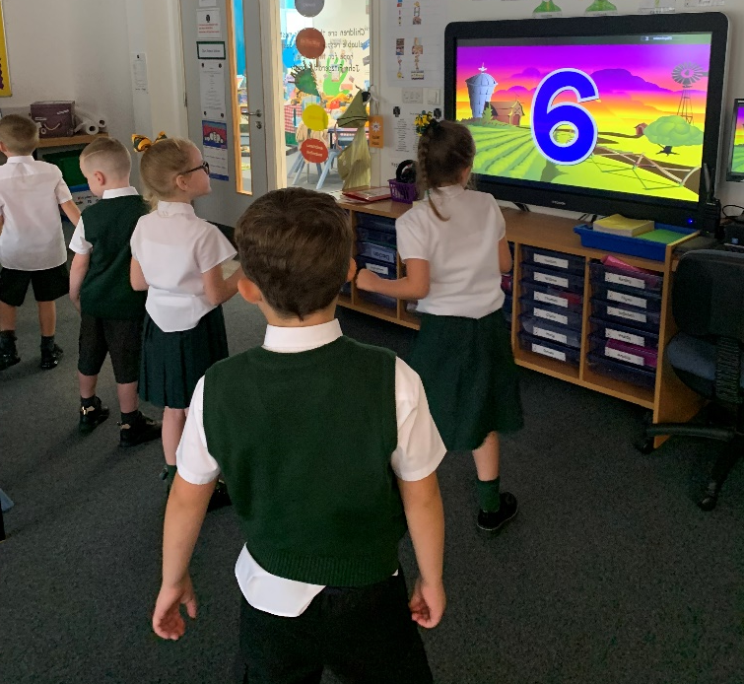
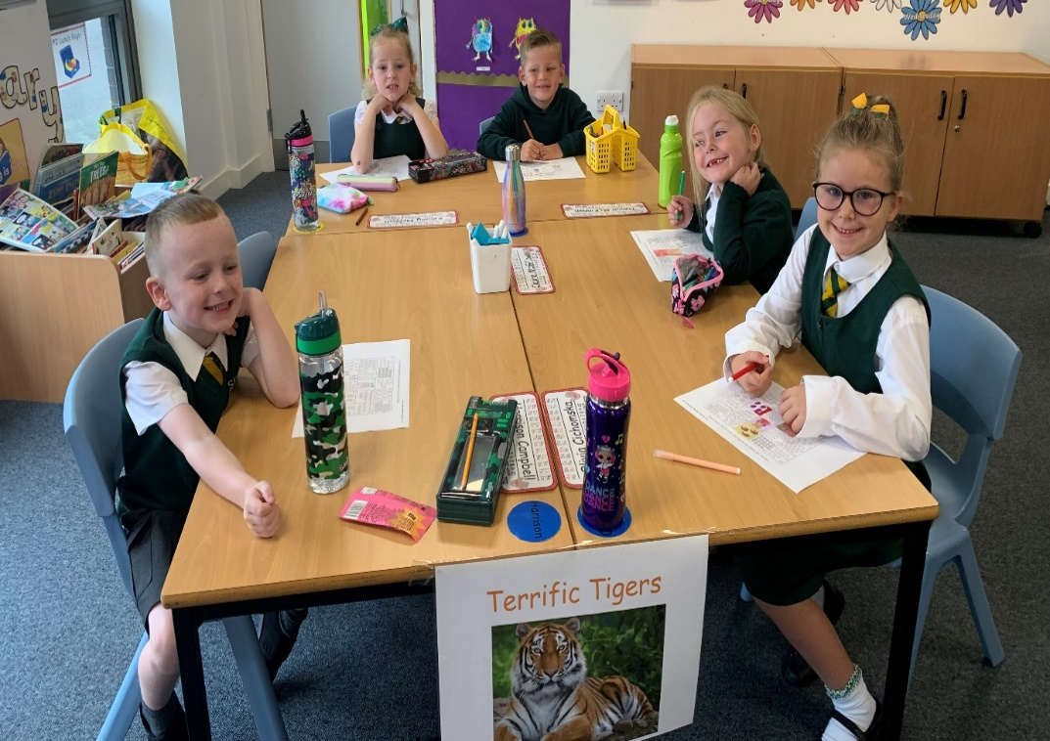
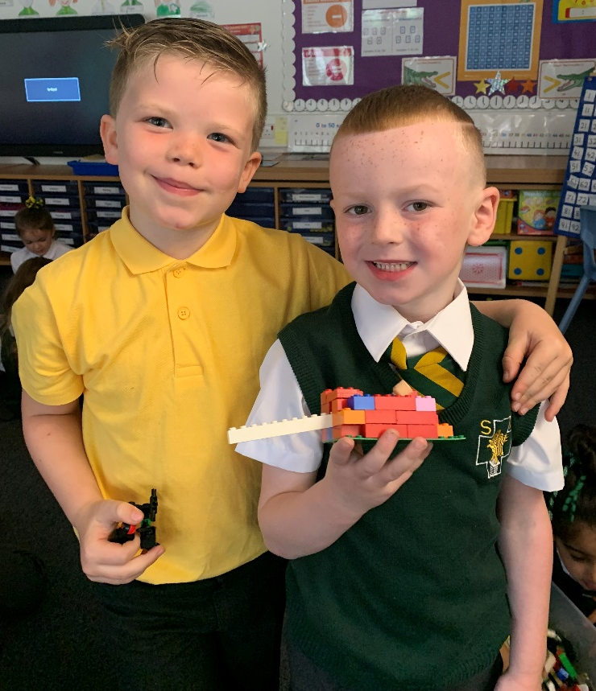
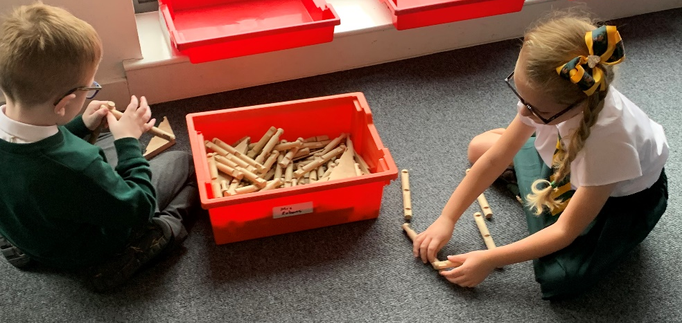

Slide 17
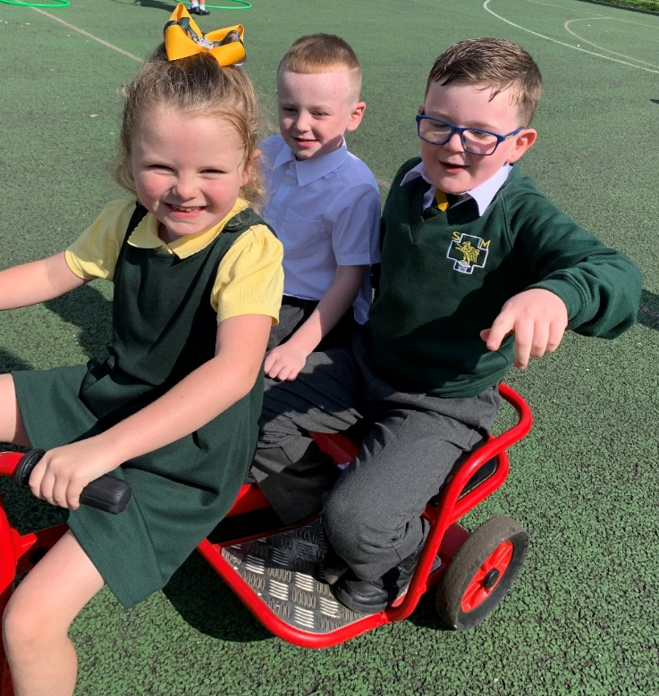
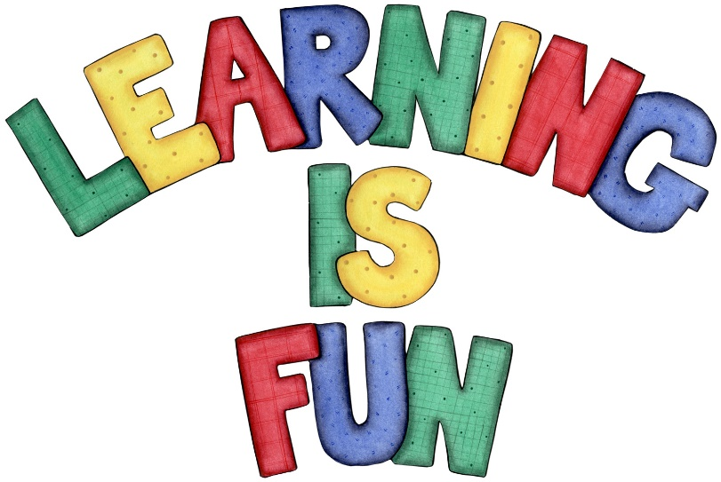
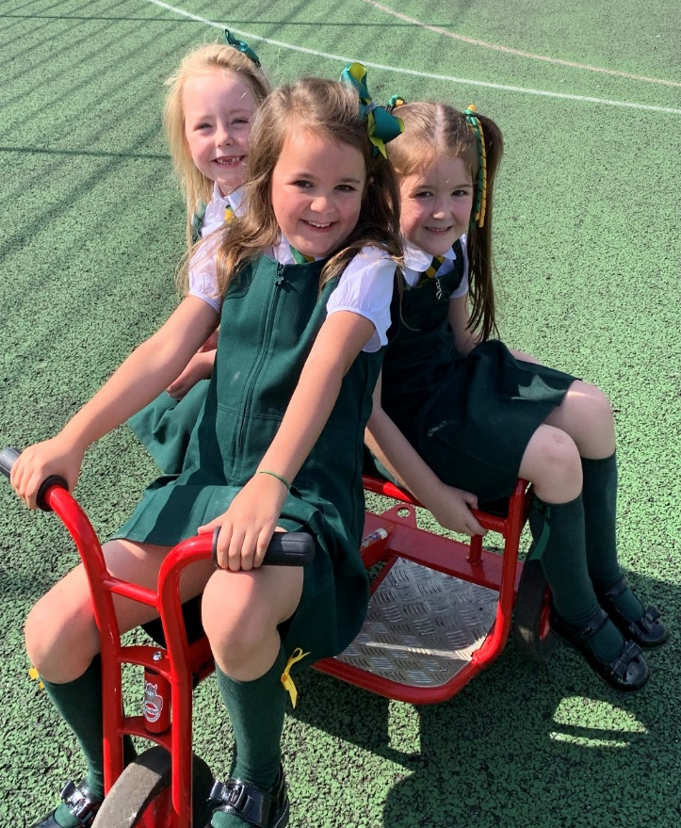
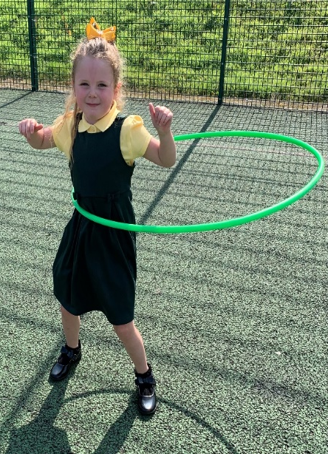
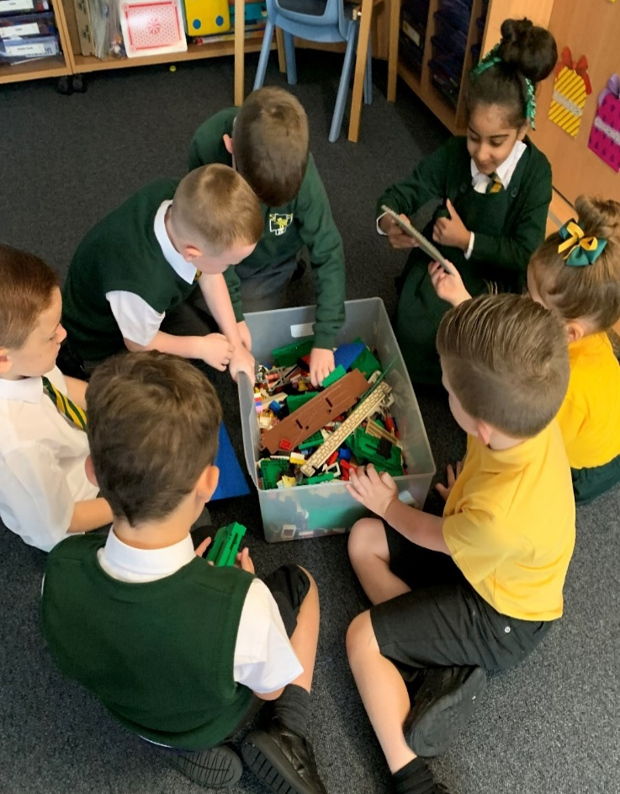
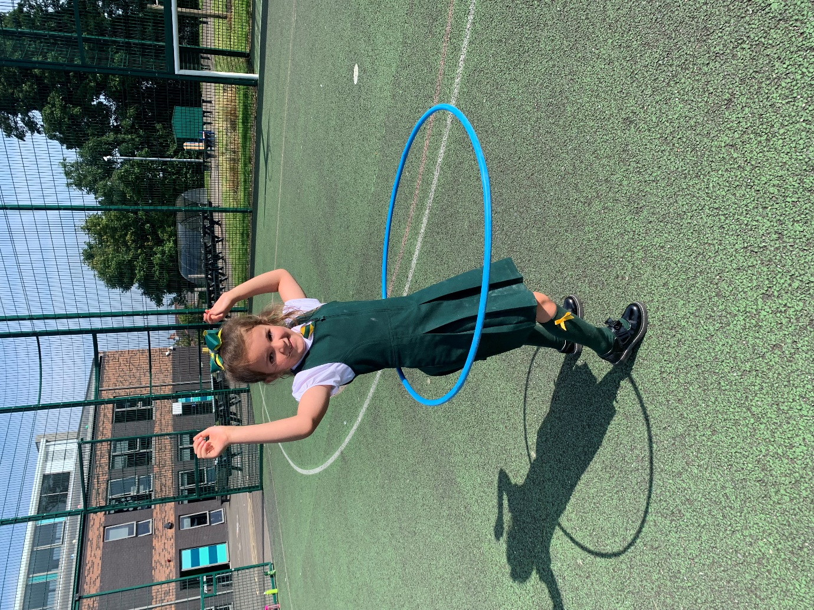
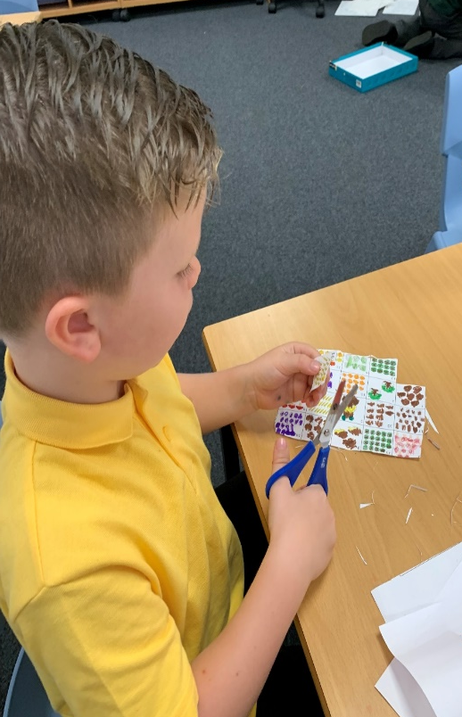
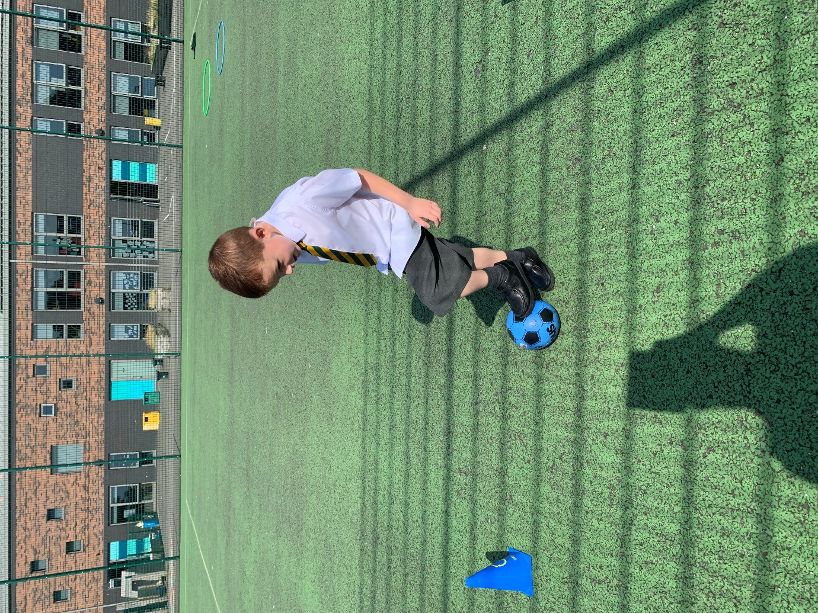

Slide 18


P2 Are Amazing!

