Slide 1

Welcome to P6!

Slide 2

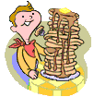
Our Classroom
Morning routine –
School Day – 9:00-3:00
Hang jackets and bags in the cloakroom.
Wash hands at the sink.
Morning prayer.
Register, lunches and plan for the day.
Starter activity/mental maths.

Slide 3
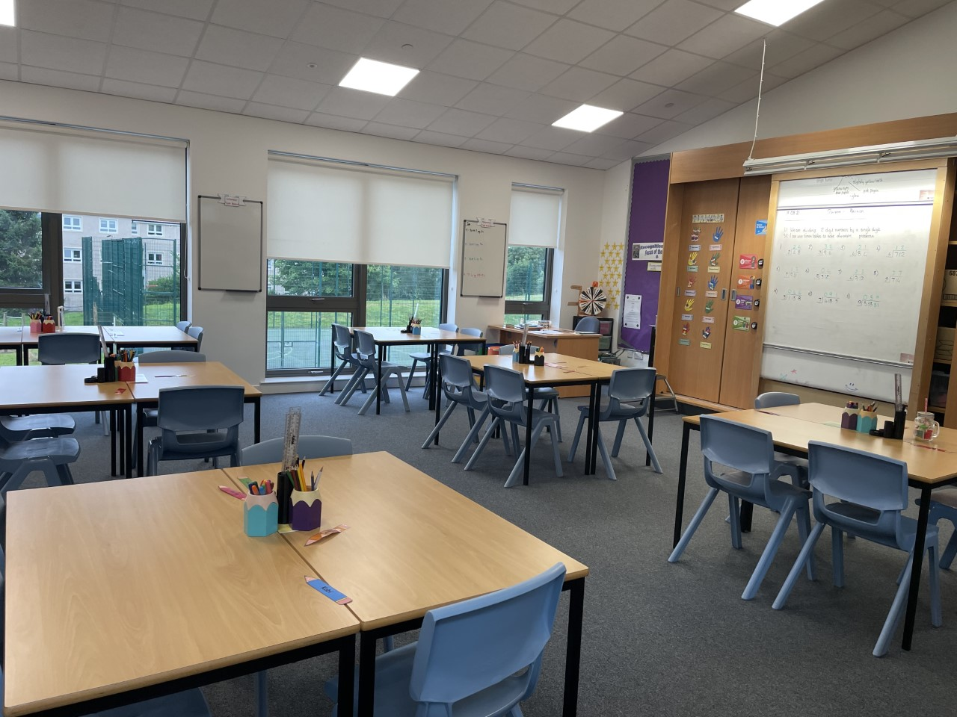
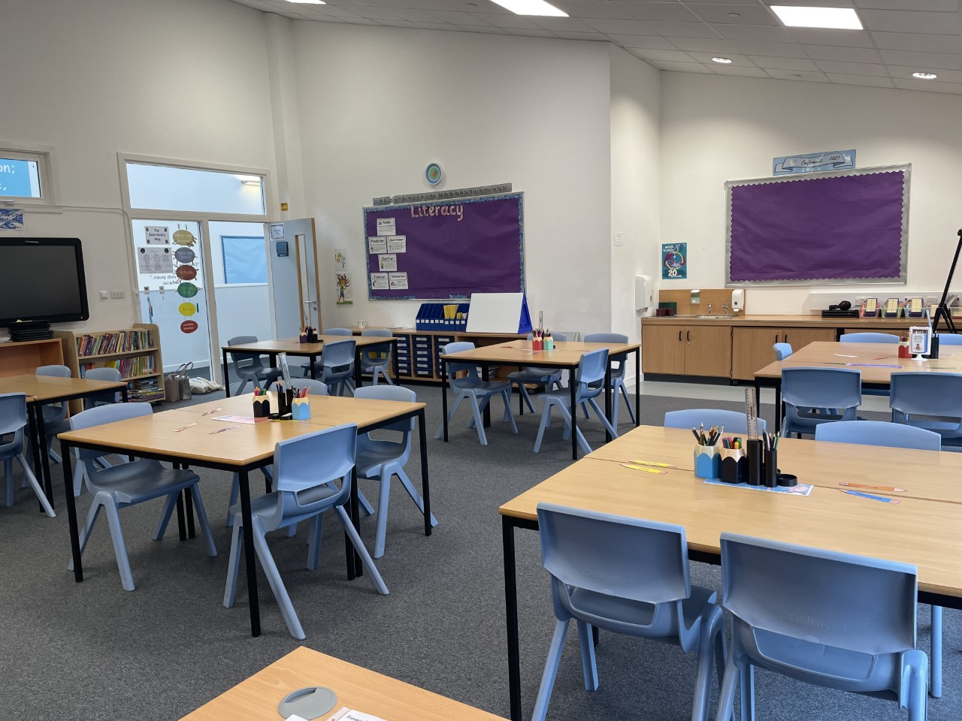
Have a look inside!

Slide 4

Promoting Positive Behaviour
RRS – Ready Respectful Safe.
St Marks Way – Start on Green each day – move up to bronze, silver & gold. Move down to amber & red.
Lunchtime reflection (red on St Marks Way) – time to reflect on what has gone wrong.
Star of the Day
Positive Notes Home
Golden Time 20-25 minutes on Friday afternoon.

Slide 5
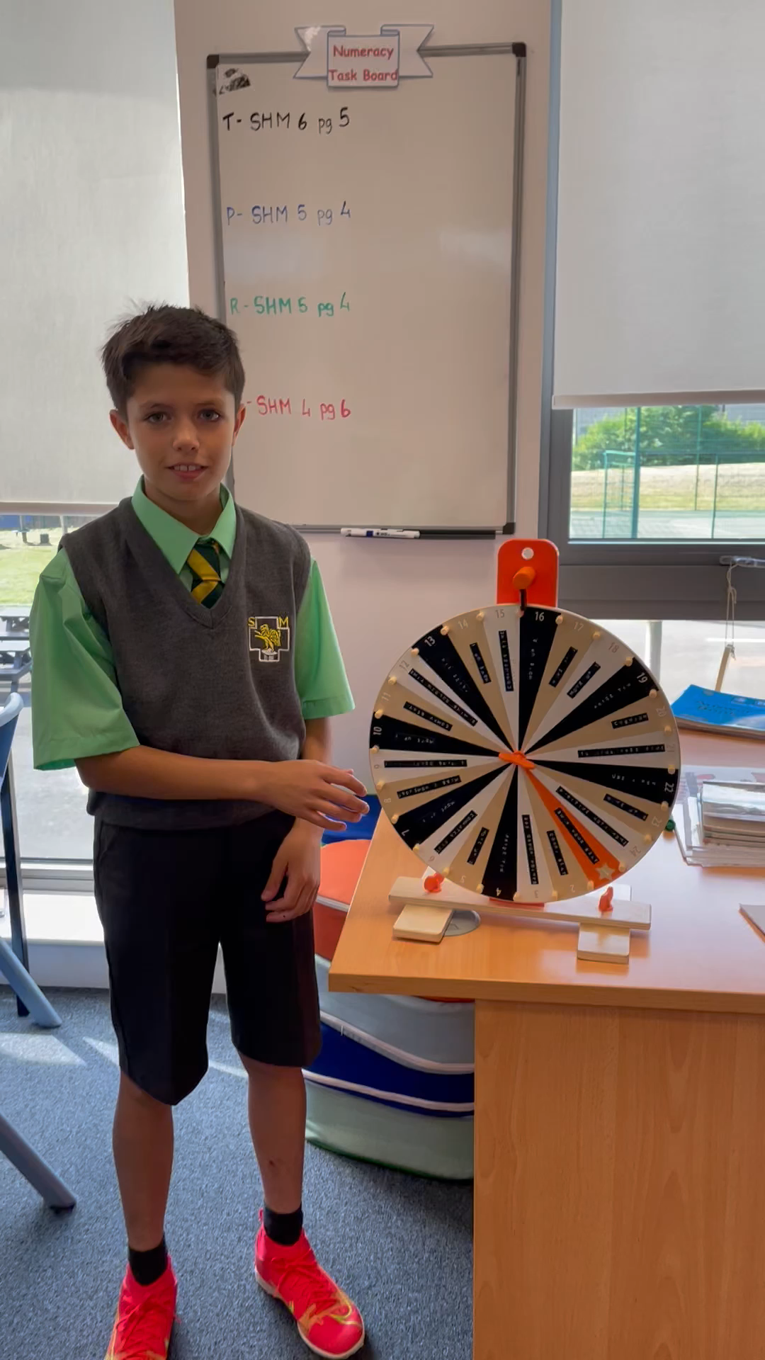
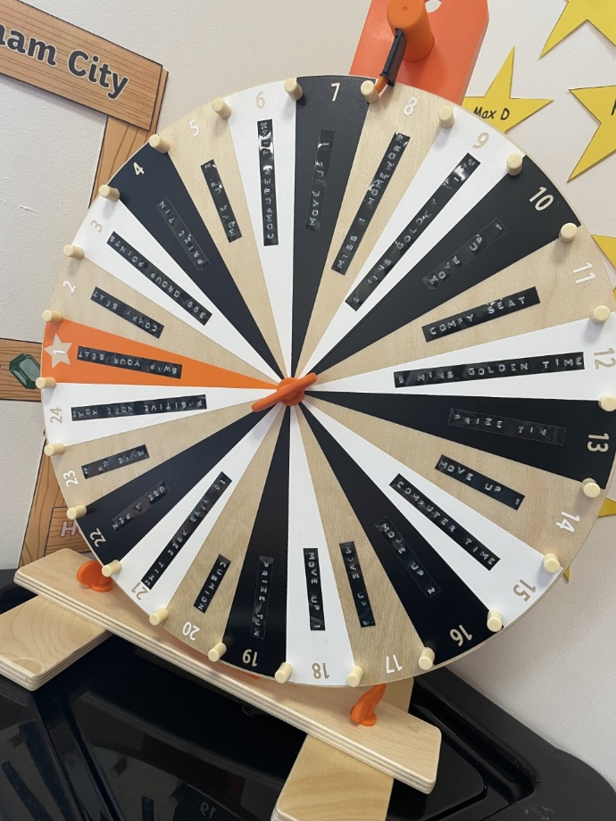
Star of the Day
Each day we have a ‘star of the day’. They spin our class wheel to decide their award!
Watch our fabulous demonstration video here!

Slide 6
Ready, Respectful & Safe
READY | RESPECTFUL | SAFE
school uniform | good listening | kind hands and feet
on time for school | use kind words and voice | safe use of resources
line up sensibly | look after our school | be online safe
use and keep cloakroom tidy | be proud of our school | give personal space
indoor shoes | be kind to others | share your worries
homework diary | include everyone | move around safely
homework | be honest
water bottle | be forgiving
PE kit | respect others
phone in box | show reverence
order lunch | can work with others
stand for prayers | give your best effort
good posture | raise hand/one voice
have a positive attitude | good manners

Slide 7
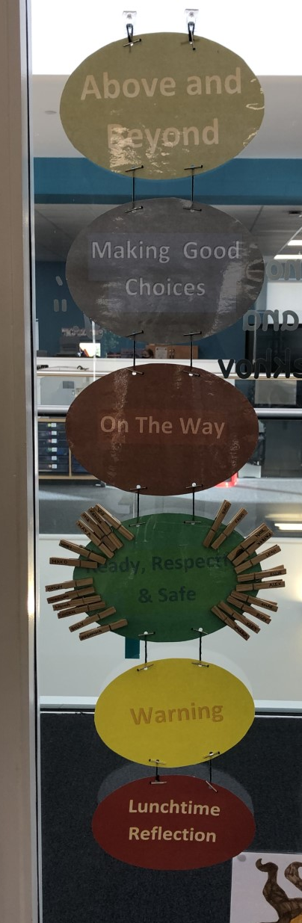
The St Marks Way
All pupils start on green every day.
Relates to RRS – move up for being ready to learn, respectful to others and safe within the school.
Move down for not showing respect, not working hard and being unsafe in the school or playground.
Finish on red – lunchtime reflection on the following day.

Slide 8







Numeracy
In class….
Interactive warm up – mental maths/whole class game.
Teacher led activities.
Independent follow up tasks – working from a variety of resources e.g. SHM, TJ maths, HAM
Mental Maths
ICT activities – topmarks, sumdog & RM Easimaths.

Slide 9
Numeracy
Ideas for home…….
TOPMARKS website for interactive games.
Education City
Times Tables practise – oral reciting
RM Easimaths – accessed through Glow.
Sumdog – logins written in homework jotter.
Shopping – using and counting money, giving change.
Time: o’clock, half past, quarter past and quarter to, 5 minute intervals

Slide 10



Reading
Reading books – Literacy World & Rapid Reader
Reciprocal Reading – using reading skills to develop understanding of a text.
ERIC time – 15 minutes daily reading of children's own choice of book.
Teacher led reading
Comprehension – Focus on Comprehension, Reading Book follow up, topic based comprehension.

Slide 11



Spelling
Phonological awareness and Spelling – North Lanarkshire Active Literacy Programme, phonics and common words
Active approaches – games ,magnetic letters, Five finger rule, multi sensory spelling activities.
Blending sounds to attack words
Dictionary/ Thesaurus Skills

Slide 12


Writing
A range of genres, often topic related.
Success Criteria for each lesson displayed at the top of work highlighting to the children what is expected in each piece of work.
Using ICT – Microsoft Word, Talk to Text & Immersive Reader.
August/September focus – developing description.

Slide 13
Literacy at Home
Reading – encourage 15 minutes per night of reading. Ask questions throughout & spot ‘WOW’ words (adjectives).
Spelling – Doorway Online
Typing – BBC Dance Mat, Doorway Online Typing.
Education City – Literacy Games

Slide 14
Health & Wellbeing
Bounce back programme – encouraging resilience and growth mindset.
ICE Pack HWB resource.
Team building activities.
Circle Time activities.

Slide 15
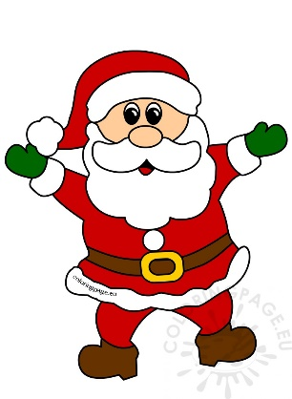

Topics
SHANARRI – rights & responsibilities of the child. Linking to class rules.
Natural Disasters– September - November
Christmas Enterprise – November – December.

Slide 16
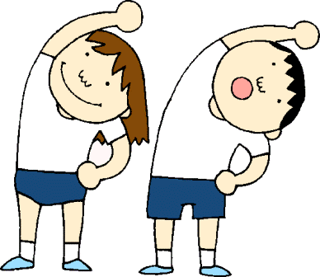


PE
Please ensure all children bring their FULL P.E. kit on Wednesday and Friday.
PE will be taking place both indoors and outdoors – dependent on weather.
Any Jewellery should be removed for P.E. days. Earrings should be covered with clear tape if they cannot be removed
Children should have plenty of water with them on P.E. days. Water is kept up in the classroom for the children returning from P.E

Slide 17
Other Curricular Areas
Primary 6 will attend Art with Mrs Hughes on a Thursday.
Mr Preston will also be working with the class on Thursdays, focussing on developing their skills in Technologies.
Science – our science focus for Term 1 will link with our topic on Natural Disasters. We will be learning about the Earth’s structure & weather.

Slide 18
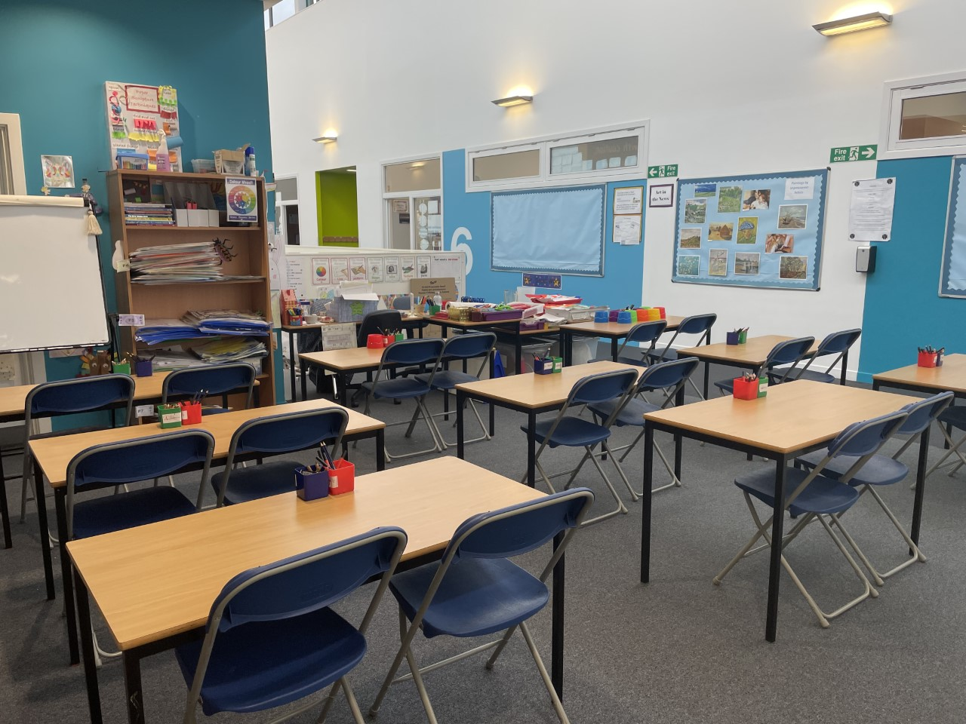
Art
Have a look inside our art area!

Slide 19
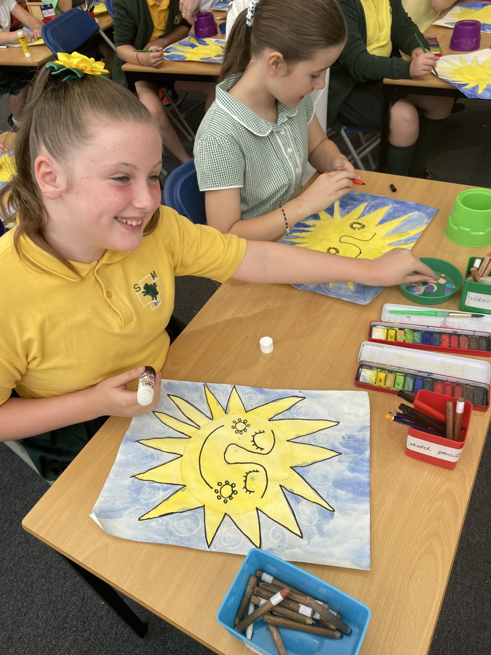
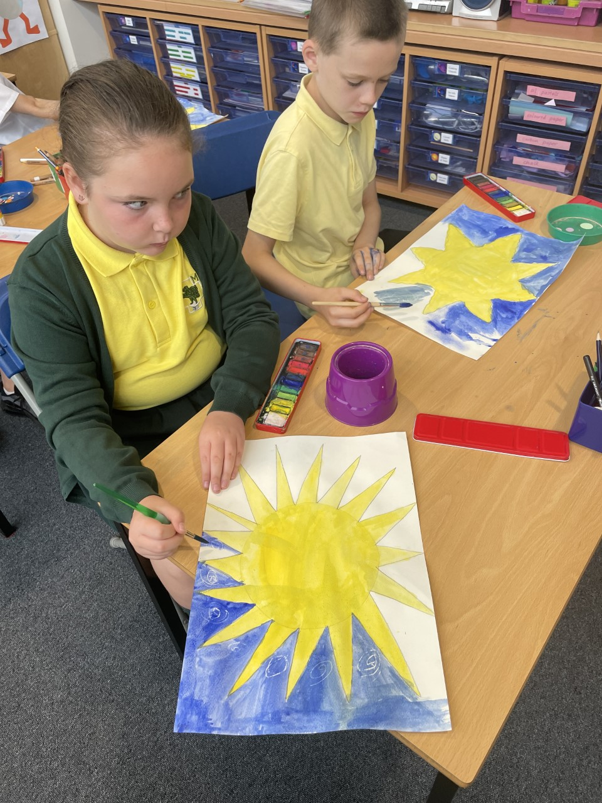
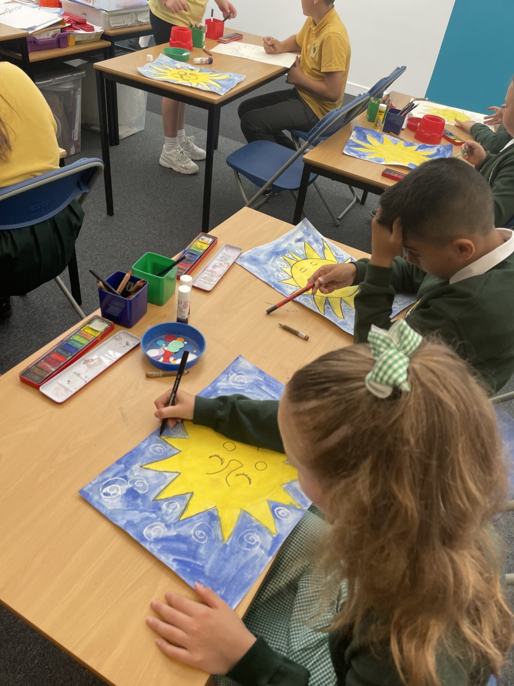
Working Hard – we LOVE art!

Slide 20
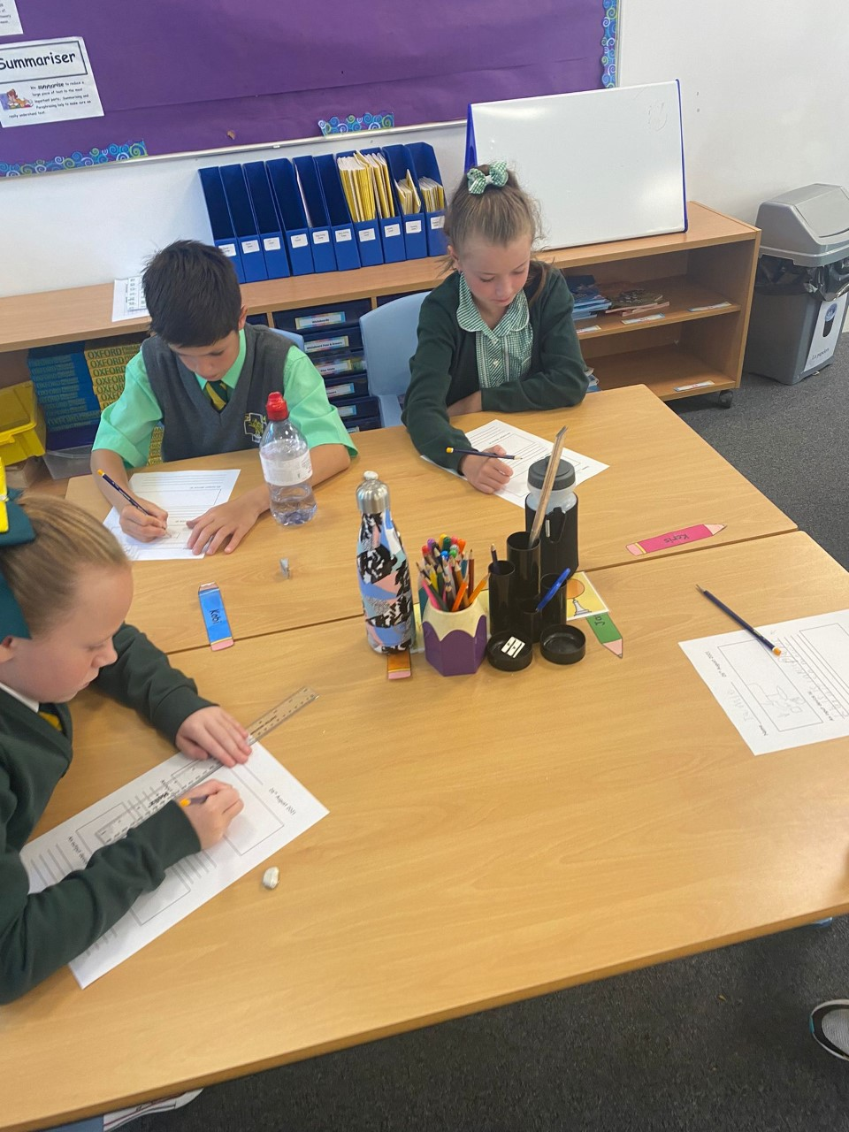
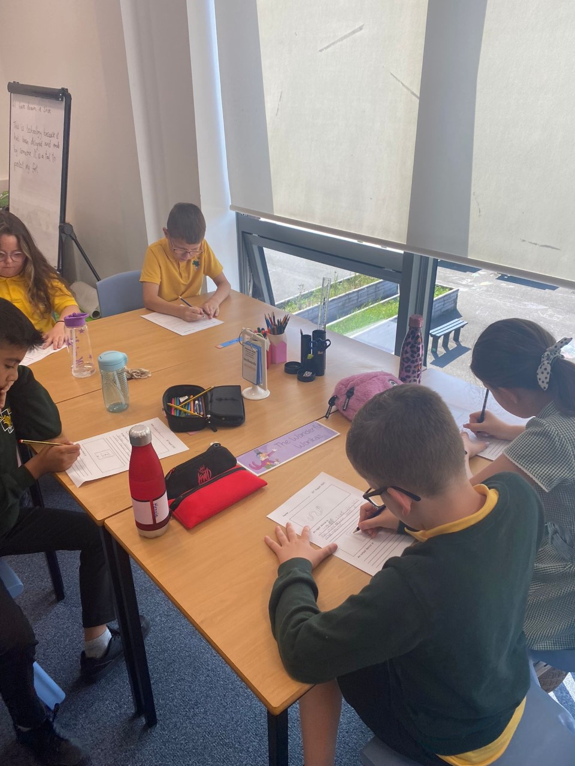
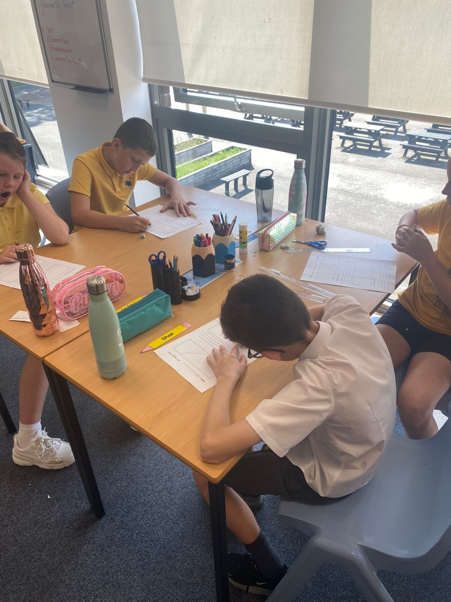
Working Hard

Slide 21
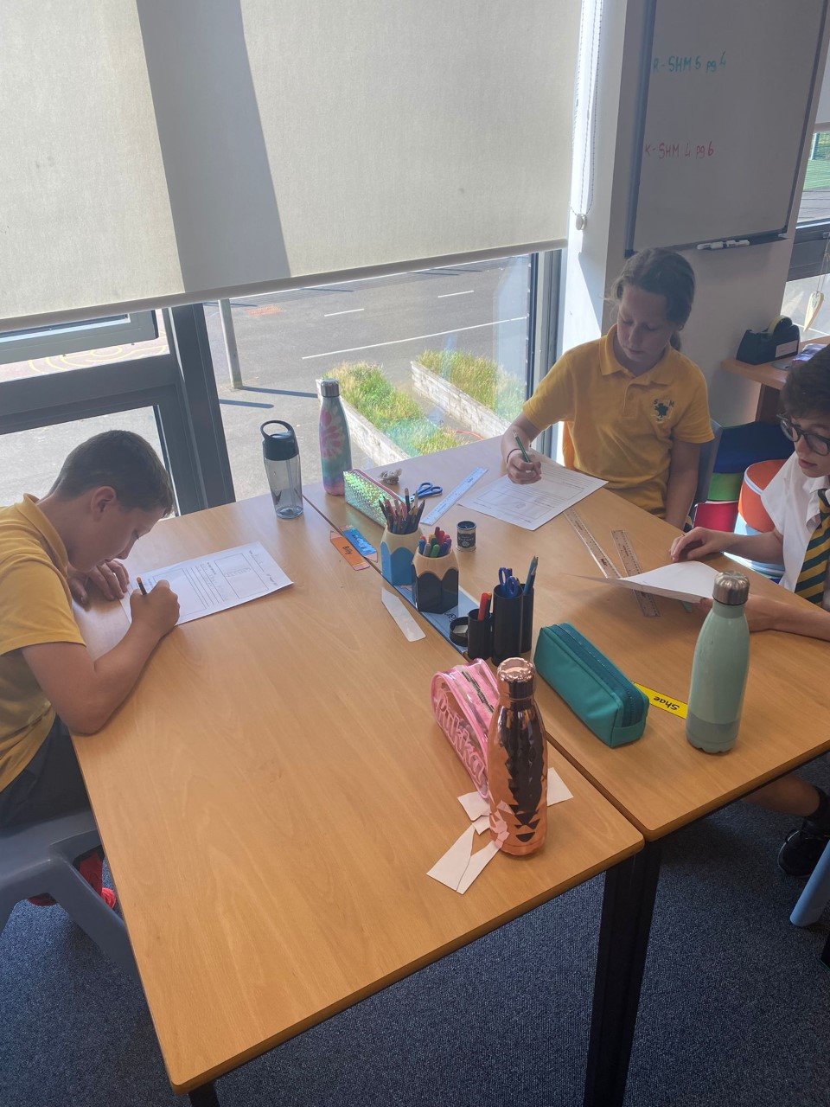
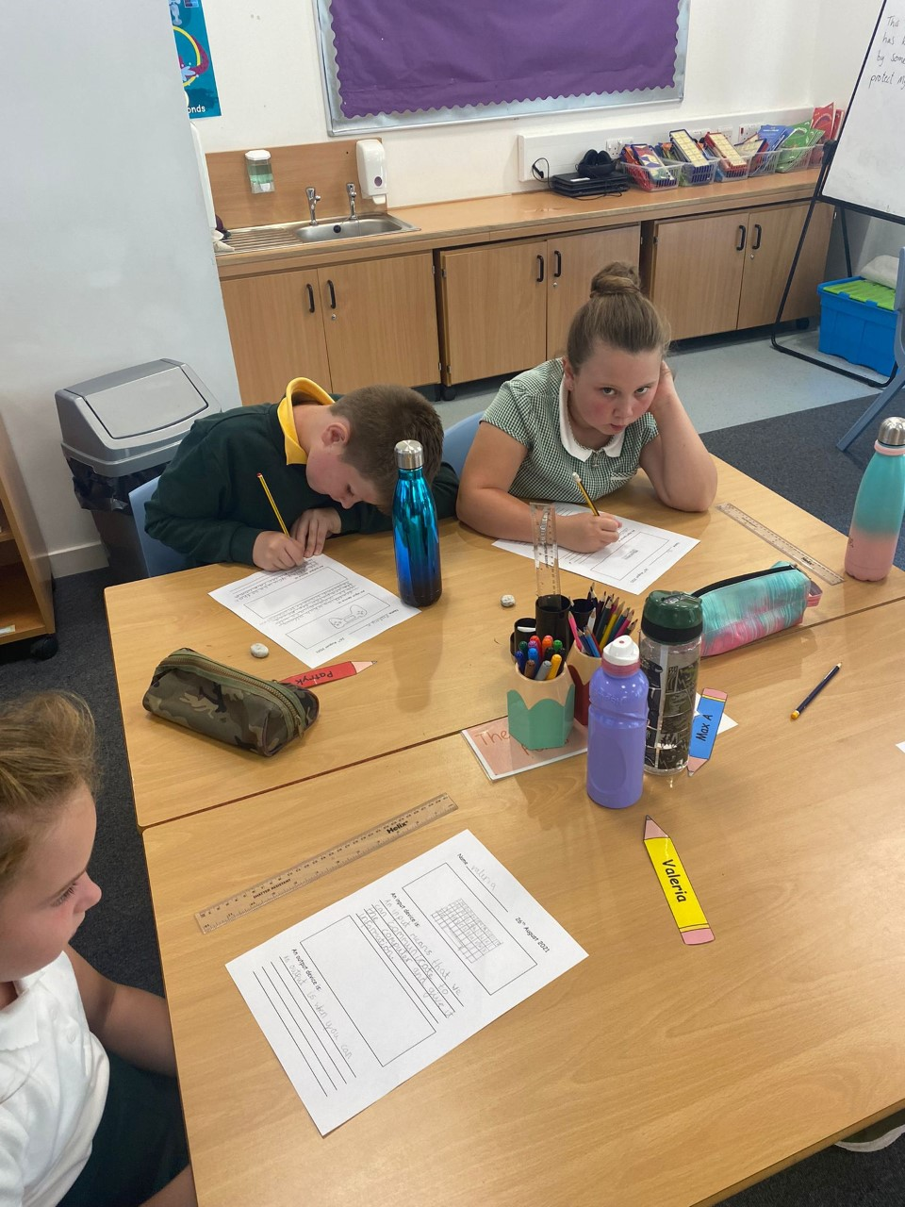
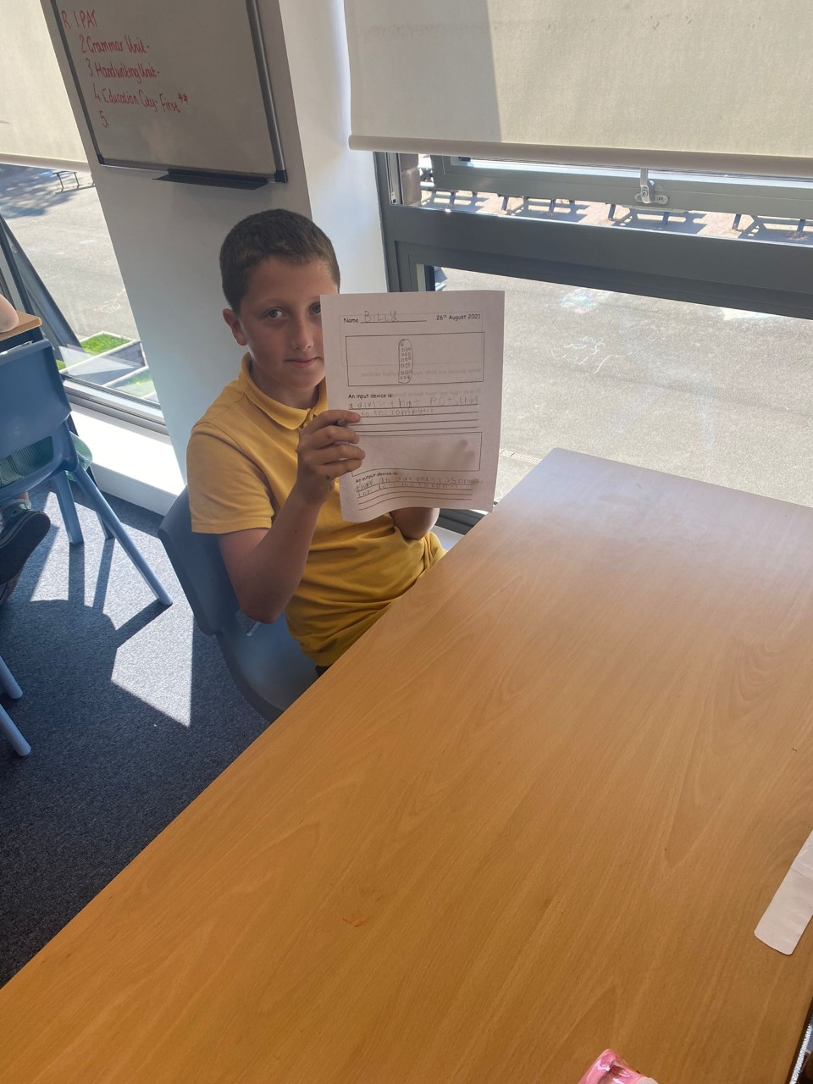
Working Hard

Slide 22


Sharing Successes.
While we are still unable to have whole school assemblies, we will be having a ‘mini assembly’ in our class on a Friday afternoon.
St Marks Marvel (pupil of the week) will be presented with their certificate.
We would also love to hear about ‘Marvellous Moments’ outside of school. Certificates/medals/awards from clubs/groups outside of school can be brought in on Fridays to share with the class.

Slide 23


Homework
After 25 minutes, STOP!!!
Will change from week to week.
Mental Maths
Written Maths
Spelling/Active Spelling
Reading/Comprehension
Topic research
Education City tasks/Google classroom may also be used.

Slide 24
Reminders
Please remind all pupils that no toys should be brought from home on any occasion. Playground equipment is provided at break and lunch and games/resources are provided for Golden Time.
Pupils should bring a water bottle every day for throughout the day in class. Please ensure this is plain water – not fizzy juice or diluting juice.
Children are encouraged to bring a healthy snack e.g an apple or banana along with a drink of water or fruit juice.
As a Health Promoting school children are not allowed cans, fizzy juice or chewing gum.
We have some pupils with nut allergies, so please ensure no nut based products are brought to school.
Keep up to date with the class on the school app and twitter!
Twitter handle: @stmarksrutherg2

